Slide 1
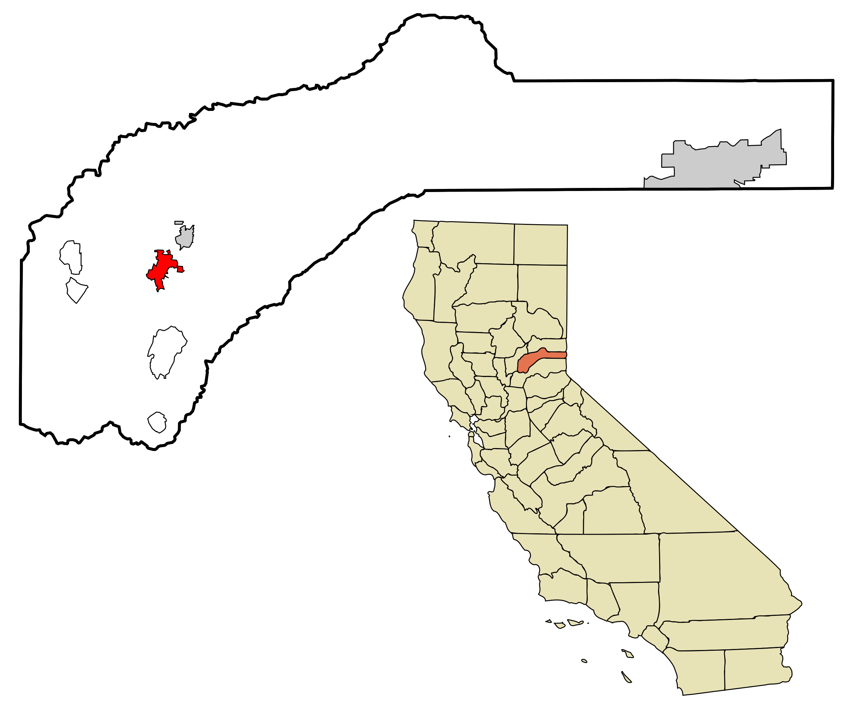

SERVING VOTERS WITH DISABILITIES
November 3, 2020 General Election
Nevada County
*Image of Nevada County and CA*
*DRC Logo*

Slide 2
There are over 5.9 million people with disabilities in California.

Slide 3
These Californians live with a variety of disabilities:
Mobility Impairments
Visual Impairments
Hearing Impairments
Cognitive & mental health impairments
Intellectual & developmental disabilities

Slide 4
Top 3 accessibility requirements for Californian voters with disabilities you should know:
Accessible Voting Locations
Vote centers should be accessible (parking, entering, navigating) for voters with disabilities. Voters with disabilities should also be able to cast a curbside vote.
Accessible Voting Systems
Every vote center must have three accessible voting systems that allow voters with disabilities to vote privately and independently.
Assistance for Voters with Disabilities
Voters with disabilities may have up to two people assist them with voting (except their employer, employer’s agent, or union member).
(SOURCES: Cal. Elections Code, §§ 4005(a)(2)(B), 12280, 14282(a) & (d), 19242)

Slide 5
Private and independent voting is everyone’s right.

Slide 6
ACCESSIBILITY TIP:
Make sure your vote center is physically accessible to voters with disabilities on each day it’s scheduled to be open.
This includes having accessible path(s) of travel and the minimum number of accessible voting machines.

Slide 7
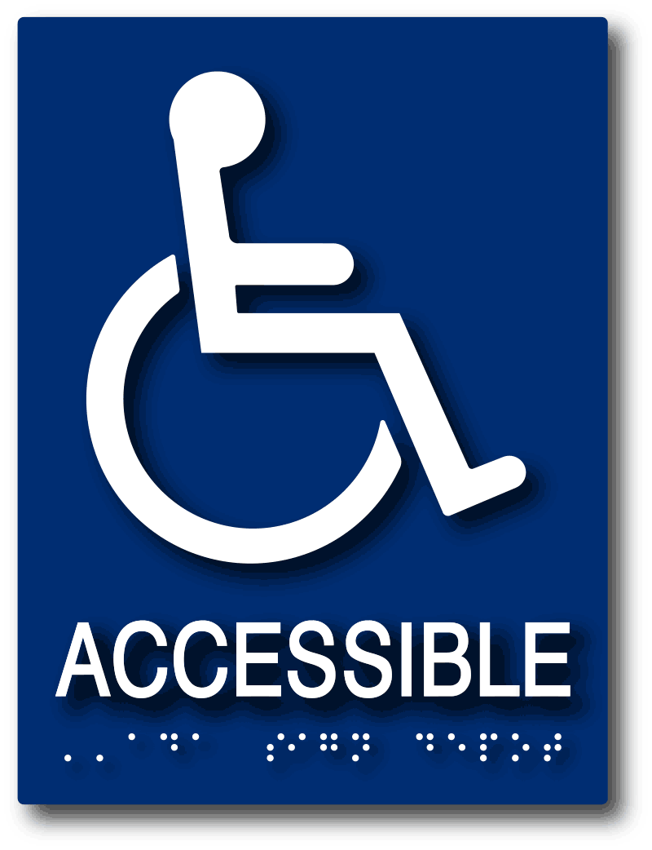
Things To Do Before Polls Open:
1. Check for accessibility barriers
Marked accessible parking near entrance?
Clear path from parking to entrance?
Clear signs with arrows leading to entrance?
Door(s) unlocked and propped open?
Elevator(s) are unlocked and working?
*ISA Logo*

Slide 8
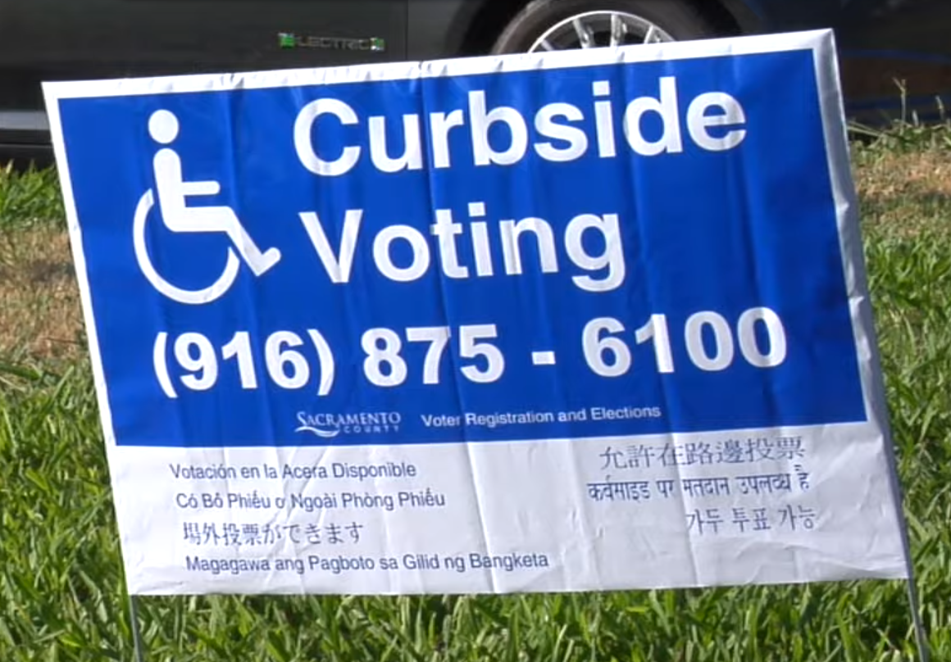
Things To Do Before Polls Open:
2. Be prepared to provide curbside voting.
Set up the curbside voting sign in a visible location outside the vote center.
Be ready to bring a regular ballot to the voter waiting outside, OR:
If bringing a regular ballot is not practical, you must bring a vote-by-mail ballot.
[COVID-19:] You should wear face and hand coverings; bring hand sanitizer (for application before and after); and maintain six (6) feet of distance whenever possible.
*Image of curbside voting yard sign*

Slide 9
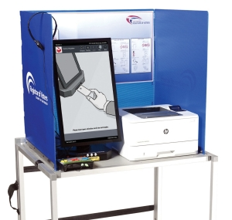
Things To Do Before Polls Open:
3. Check the accessible voting systems.
Set up the accessible voting systems
Ensure that poll workers know how to operate it and assist voters using them
*Image of voting machine*

Slide 10
ACCESSIBLE VOTING SYSTEM (TIP 1):
Poll workers should offer the accessible voting systems
to every voter.

Slide 11
Because …
Voters may need an accessible voting system but might not know to ask.
AND
This helps ensure each voting system is plugged in and operational for all.

Slide 12
ACCESSIBLE VOTING SYSTEM (TIP 2):
Poll workers should be familiar
with the accessible voting system.

Slide 13
Because …
Poll workers should know how to set up each system and must be able to explain to voters how to use them.
AND
Errors and other equipment failures can (and do!) occur. Poll workers must know how to troubleshoot those issues.

Slide 14
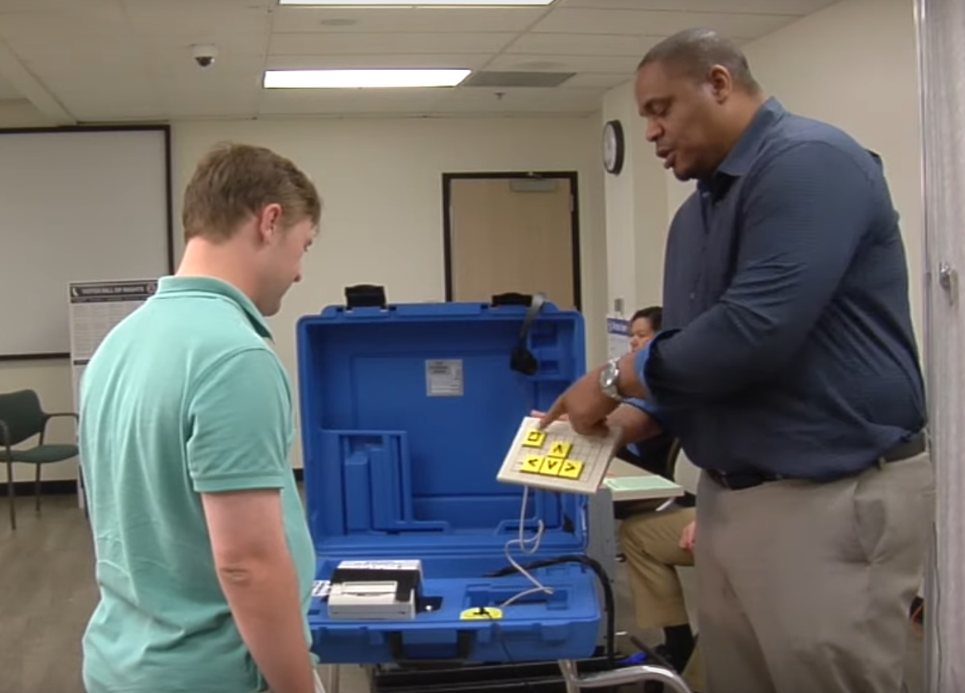
ONCE THE Polls Open:
4. Be ready to assist (or let others assist) voters.
Poll workers should be prepared to assist any voter who requests help with voting.
Poll workers must allow up to two people assist voters with disabilities.
Poll workers must keep the voter’s choices confidential.
*Image of poll worker assisting voter*

Slide 15
BUT REMEMBER:
Assisting voters with disabilities is not a substitute for having the accessible voting systems.

Slide 16
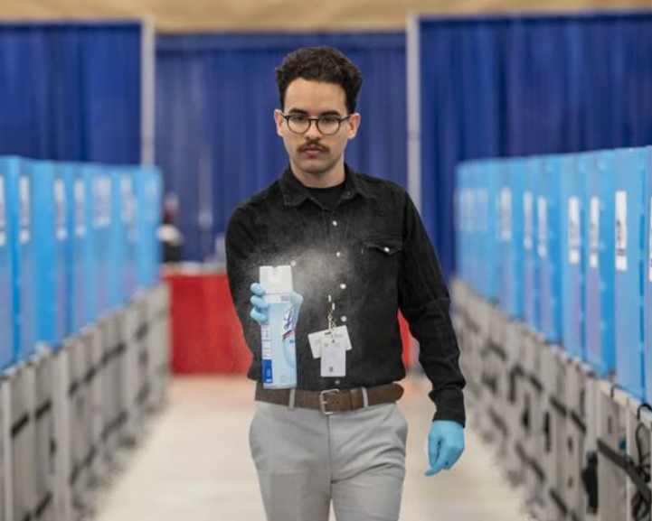
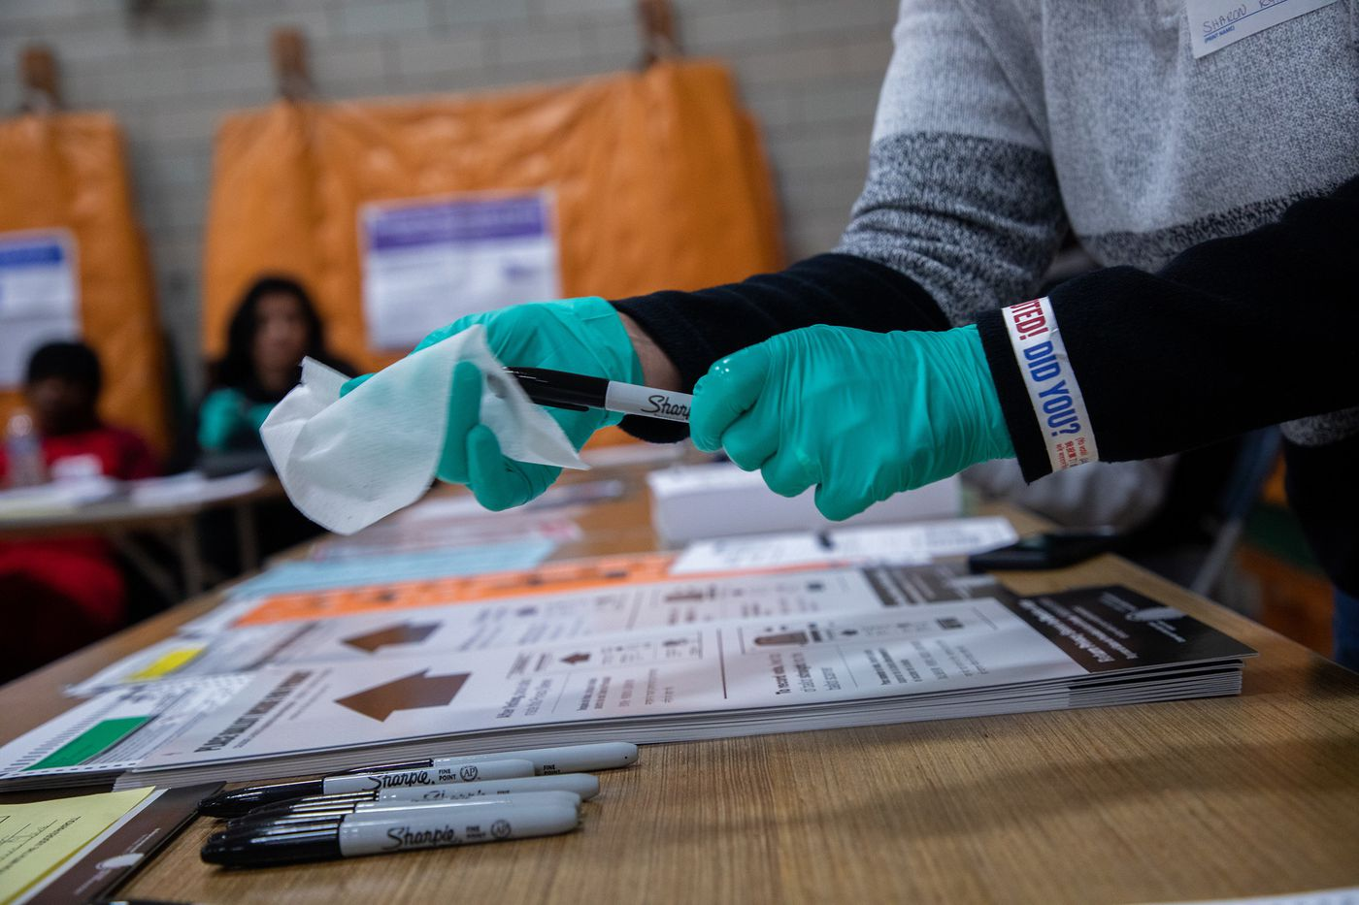
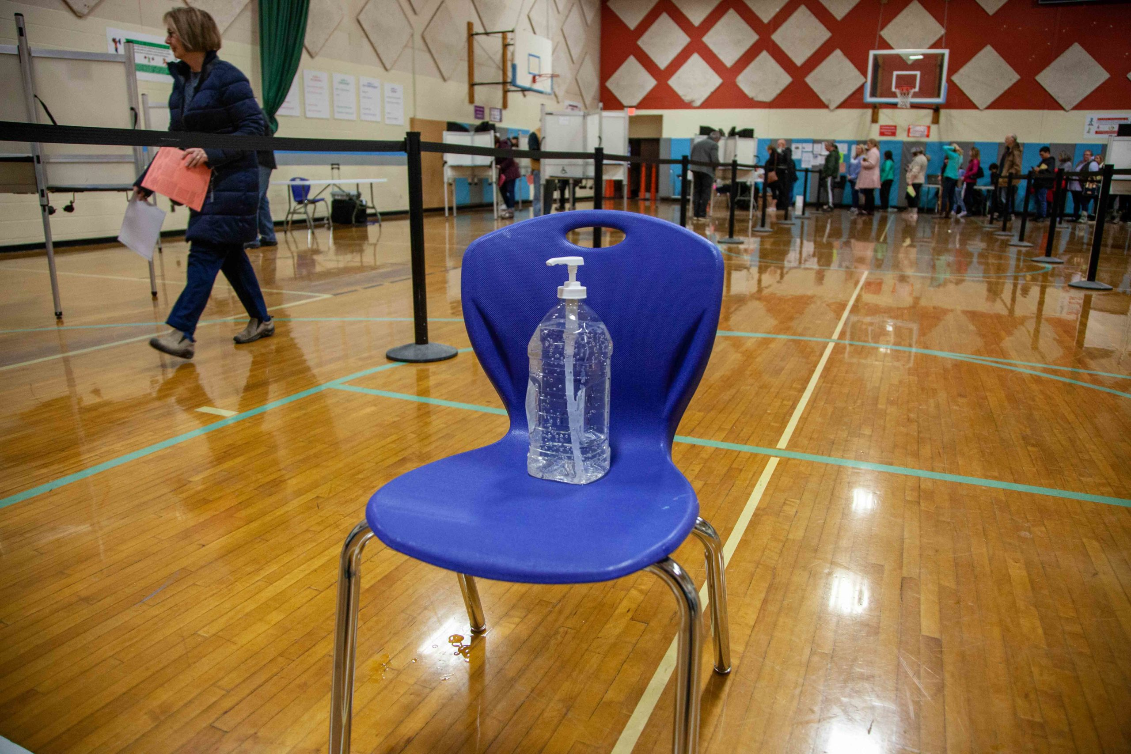
During COVID-19 ...
You MUST allow everyone to vote without undue delay,
even if they do not (or cannot!) abide by COVID-19 precautions.
*Image of poll worker with disinfectant*
*Image of poll worker disinfecting pen*
*Image of hand sanitizer in polling place*
(SOURCE: SOS’s July 21, 2020 CC/ROV (Memo No. 20154)

Slide 17
More Tips:
1. Communicate effectively to voters with disabilities.
Make eye contact.
Wait until the person can see you before speaking.
Look at the person while speaking.
Speak clearly and in a normal voice.
Make sure your face and lips are visible.
Use good lighting—but don’t stand in front of the light source.
Repeat or rephrase your question or statement if needed.
Have paper and pencil ready to exchange written info if needed.

Slide 18
More Tips:
2. Disability Etiquette: treat all voters with dignity and respect.
Say “a person with a disability,” not “disabled person.” *
Do not say “handicapped” when referring to a person with a disability.
Offer assistance before helping. If accepted, listen to any instructions provided.
Share the same social courtesies as you would with someone else. **
Guide (rather than lead or propel) voters with visual impairments by letting them take your arm. When guiding, use specific directions like “right in five feet.
Speak directly the voter, not to their companion. The same applies for voters using sign language: speak to them, not the interpreter.
Always identify yourself and others (e.g., “on my right is John Smith”) when addressing voters with visual impairments. Speak normally and indicate when the conversation is over. Let them know when you move from one place to another.
Notes:
* Unless absolutely necessary due to limited paper space or announcement time.
** Except courtesies involving physical touching, like hand-shaking (due to COVID-19).

Slide 19
(For more on disability etiquette, see: http://www.unitedspinal.org/pdf/disabilityetiquette.pdf)

Slide 20
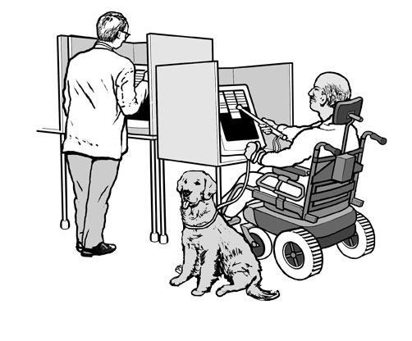
Last Tip:
3. Allow voters with service animals to vote.
Some voters with disabilities may be accompanied by a service animal.
Federal anti-discrimination laws require poll workers to permit these service animals to assist voters with disabilities.
(SOURCE: 28 C.F.R. § 35.130(b)(7))
*Illustration of a voter voting with a service dog*

Slide 21
Thank you!
Disability Rights California
by Fred Nisen and Jason Connor
Fred.Nisen@disabilityrightsca.org
Jason.Connor@disabilityrightsca.org

