Slide 1
Pesticides and Cannabis
An overview of pesticides as they relate to cannabis production.

Slide 2
Pesticides and Cannabis
Pesticides
General Pesticide Safety
Mixing and Applying Pesticides
Pesticide Containers and Storage
Enforcement and Inspections
Permits

Slide 3

Role of California Ag Commissioners (CAC’s)
Performing inspections, compliance monitoring, and compliance assistance that focus on protecting pesticide applicators and workers
Investigating all priority incidents and illnesses
Issuing CEQA-compliant pesticide permits
Enforcing the requirements of pesticide product labeling and ensuring safe use.
The authority to perform these activities is defined in the Food and Ag Code (FAC) and California Code of Regulations (CCR).

Slide 4
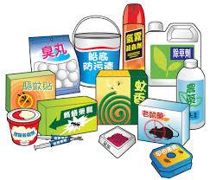
What is a pesticide?
Pesticide is an umbrella term for all herbicides, rodenticides, miticides, fungicides, antimicrobials, etc.
A pesticide is defined as anything used to mitigate a pest.
Pesticides are also used in organic agriculture.

Slide 5
Some misconceptions
Organic does not equal lack of pesticide use.
“Home use only” products available at most garden centers and hardware stores cannot be used in the production of a commercial agricultural commodity.
Homemade remedies are still pesticides and subject to FIFRA.
Anything used as a pesticide falls under FIFRA, and needs to have a label to determine correct use. Common household products like soap or vinegar do not have a pesticide label, so any use of such a product to control pests is an off-label use and a violation.

Slide 6
Pesticide Registration
US EPA and DPR review all new pesticides prior to registration to ensure effectiveness and will not harm human health or the environment when used according to label directions.
Under FIFRA, a small subset of low-risk pesticides are exempt from registration if they meet certain criteria, (Section 25b), and are typically substances such as garlic, peppermint, rosemary, cedar and castor oil.
There are other FIFRA exemptions, ie beneficial insects and mechanical devices.

Slide 7

The Label is Law!!
The pesticide label is a legal document.
Products must be labeled properly, and found suitable for the intended use.
All pesticide product labels include a signal word, warning statement, precautionary statements for protecting human and environmental health, storage and disposal statements, and directions for use.
By law, all pesticide users must follow the label. Any off label use of a pesticide use is a violation.

Slide 8
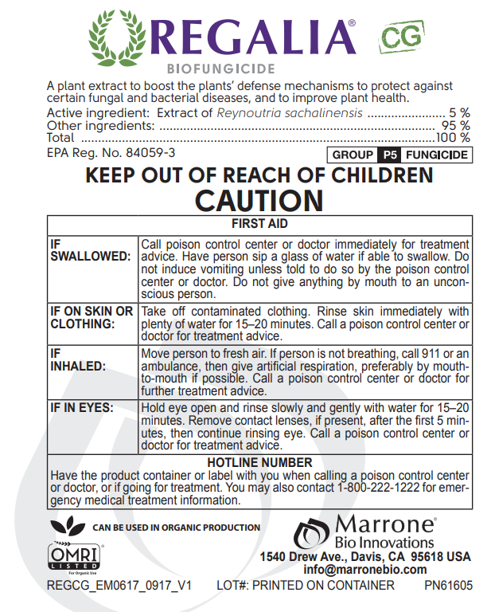
Elements of a label
Name
Active ingredients
EPA Reg. No.
Signal Word: Caution
First Aid Instructions
Manufacturer

Slide 9
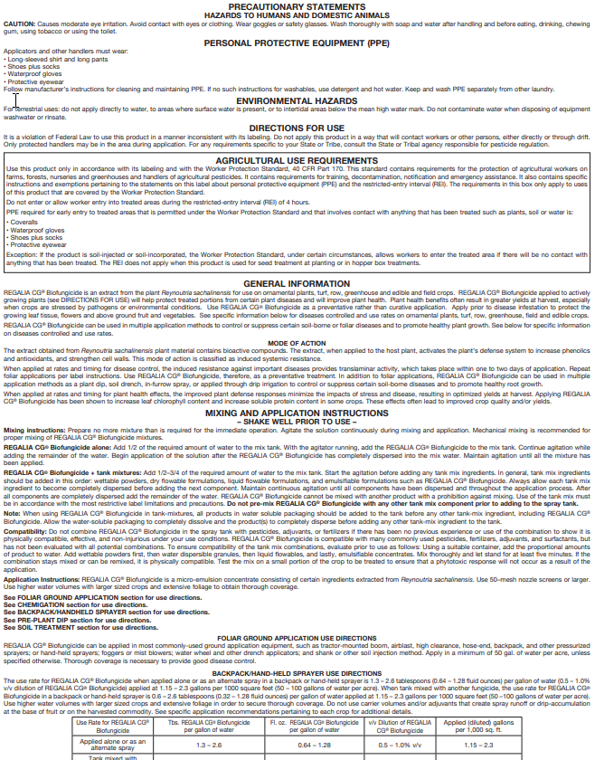
Elements of a label
Precautionary Statements
Required PPE
Environmental Hazards
Directions for Use – FIFRA statement
Agricultural Use Requirements
Restricted Entry Interval (REI)
General Information
Mixing and Application Instructions, with notes on types of mixtures and applications, continues

Slide 10
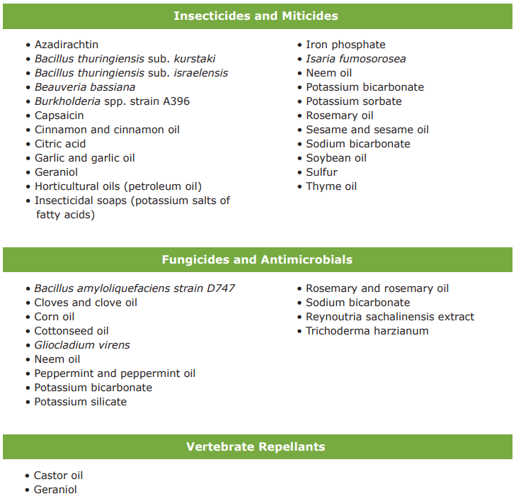
Possibly Allowed Active Ingredients
This is not an exhaustive list of active ingredients that may fit the legal use criteria. DPR/Ag Commissioner does not track products that fit the criteria and the user bears the responsibility for ensuring product labels meet the criteria.

Slide 11
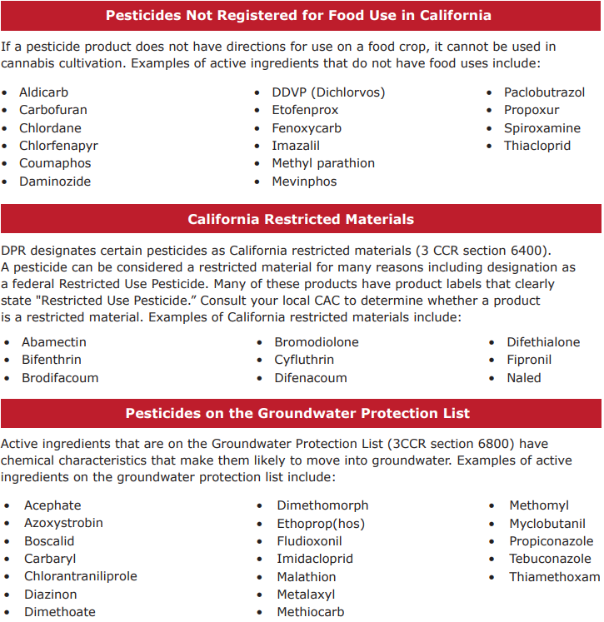
Never allowed!
The following criteria identify pesticide products that cannot be used in California cannabis cultivation under any circumstances. The use of any pesticides meeting any one of these criteria on cannabis will be strictly enforced as a violation of the FAC and could result in civil or criminal penalties (FAC sections 12996 and 12999.5)
Residues found in any amounts of these substances will fail testing.

Slide 12
Residue Tolerances Category 1 and 2
 | Action Level (μg/g)
Residual Pesticide | CAS No. | Inhalable Cannabis Goods | Other Cannabis Goods
Abamectin | 71751-41-2 | 0.1 | 0.3
Acephate | 30560-19-1 | 0.1 | 5
Acequinocyl | 57960-19-7 | 0.1 | 4
Acetamiprid | 135410-20-7 | 0.1 | 5
Azoxystrobin | 131860-33-8 | 0.1 | 40
Bifenazate | 149877-41-8 | 0.1 | 5
Bifenthrin | 82657-04-3 | 3 | 0.5
Boscalid | 188425-85-6 | 0.1 | 10
Captan | 133-06-2 | 0.7 | 5
Carbaryl | 63-25-2 | 0.5 | 0.5
Chlorantraniliprole | 500008-45-7 | 10 | 40
Clofentezine | 74115-24-5 | 0.1 | 0.5
Cyfluthrin | 68359-37-5 | 2 | 1
Cypermethrin | 52315-07-8 | 1 | 1
Diazinon | 333-41-5 | 0.1 | 0.2
Dimethomorph | 110488-70-5 | 2 | 20
Etoxazole | 153233-91-1 | 0.1 | 1.5
Fenhexamid | 126833-17-8 | 0.1 | 10
Fenpyroximate | 111812-58-9 | 0.1 | 2
Flonicamid | 158062-67-0 | 0.1 | 2
Fludioxonil | 131341-86-1 | 0.1 | 30
Hexythiazox | 78587-05-0 | 0.1 | 2
Imidacloprid | 138261-41-3 | 5 | 3
Kresoxim-methyl | 143390-89-0 | 0.1 | 1
Malathion | 121-75-5 | 0.5 | 5
Metalaxyl | 57837-19-1 | 2 | 15
Methomyl | 16752-77-5 | 1 | 0.1
Myclobutanil | 88671-89-0 | 0.1 | 9
Naled | 300-76-5 | 0.1 | 0.5
Oxamyl | 23135-22-0 | 0.5 | 0.2
Pentachloronitrobenzene | 82-68-8 | 0.1 | 0.2
Permethrin | 52645-53-1 | 0.5 | 20
Phosmet | 732-11-6 | 0.1 | 0.2
Piperonylbutoxide | 51-03-6 | 3 | 8
Prallethrin | 23031-36-9 | 0.1 | 0.4
Propiconazole | 60207-90-1 | 0.1 | 20
Pyrethrins | 8003-34-7 | 0.5 | 1
Pyridaben | 96489-71-3 | 0.1 | 3
Spinetoram | 187166-15-0, 187166-40-1 | 0.1 | 3
Spinosad | 131929-60-7, 131929-63-0 | 0.1 | 3
Spiromesifen | 283594-90-1 | 0.1 | 12
Spirotetramat | 203313-25-1 | 0.1 | 13
Tebuconazole | 107534-96-3 | 0.1 | 2
Thiamethoxam | 153719-23-4 | 5 | 4.5
Trifloxystrobin | 141517-21-7 | 0.1 | 30
Category I
Residual Pesticide | CAS No.
Aldicarb | 116-06-3
Carbofuran | 1563-66-2
Chlordane | 57-74-9
Chlorfenapyr | 122453-73-0
Chlorpyrifos | 2921-88-2
Coumaphos | 56-72-4
Daminozide | 1596-84-5
DDVP (Dichlorvos) | 62-73-7
Dimethoate | 60-51-5
Ethoprop(hos) | 13194-48-4
Etofenprox | 80844-07-1
Fenoxycarb | 72490-01-8
Fipronil | 120068-37-3
Imazalil | 35554-44-0
Methiocarb | 2032-65-7
Methyl parathion | 298-00-0
Mevinphos | 7786-34-7
Paclobutrazol | 76738-62-0
Propoxur | 114-26-1
Spiroxamine | 118134-30-8
Thiacloprid | 111988-49-9

Slide 13
Ag Commissioner Pest Management Review
Must have an actual product to review, ie Regalia CG EPA Reg No. 84059-3, not just a generic active ingredient.
Is it an allowed active ingredient?
Is the label broad enough to interpret for use on cannabis?
Is it intended for agricultural production vs home use?
Will the listed inert ingredients be a problem for EPA Food Residue Tolerances?
CalCannabis License Applications require a pest-management plan to include a signed attestation that the applicant shall contact the appropriate County Agricultural Commissioner prior to using the pesticides listed in the pest-management plan. Sections 8106(a)(3)(C)

Slide 14
Selecting and Purchasing the Right Pesticide
Read the label. Does the pesticide pass all of the criteria from the previous slide?
Beware of pesticides promoted through the internet, especially from out-of-state. You may be unknowingly purchasing materials that are not registered for use in the state, which could subject you to enforcement actions.

Slide 15
General pesticide safety

Slide 16
Pesticide Hazards and Concerns
Reading the pesticide label is one of the most important steps in making a pesticide application.
Are there stated hazards such as exposure to handlers or fieldworkers? Concerns for drift? Potential for groundwater contamination? Other precautions including tank mix restrictions?
Is there a pre-harvest interval?
What is the restricted entry interval for each product?
Are there phytotoxicity concerns?
Is additional personal protective equipment required?

Slide 17
Possible Exposure Routes
Pesticides can enter your body through these four routes of exposure:
Dermal (skin)
Oral (mouth)
Respiratory (lungs)
Ocular (eyes)

Slide 18
Restricted Entry Interval (REI)
When a pesticide is applied on your property, neither you nor your employees can enter the treated area until a specified period of time has elapsed unless the proper REI PPE is worn.
This applies to the entire “site”, whether that is a greenhouse, hoop house or the entire outdoor cultivated area.

Slide 19

Personal Protective Equipment
The use of pesticides, with few exceptions, requires the applicator wear at least long pants, long sleeves, safety glasses/goggles (Z87+), chemical resistant gloves (min 14 mL), sock and shoes.
Pesticide labels may require additional equipment, such as a respirator or chemical resistant clothing.
PPE may not be stored with pesticides.
It is the employers responsibility to provide and maintain all necessary PPE.

Slide 20
Pesticide Labels and SDS
You are required to have a copy of the pesticide label and safety data sheet (SDS) at the mix/load and application. These are typically stored in a binder or file at a central location at the workplace, away from the pesticide storage.

Slide 21
Mixing and applying pesticides

Slide 22
Preparing for an application
Read all directions on the label and ensure you can follow all requirements.
Calculate the amount of pesticide and water you will need for your application.
Check the application equipment for cracks or other leaks, and that the filters, screens, and nozzles are clean.
Have an emergency supply of soap, disposable single-use towels and clean water nearby.
Wear all minimum PPE as required, even if not specified on the label.

Slide 23
Mixing
Select a mixing location that can be cleaned easily should an accident occur. Consider the surroundings and the environmental impact.
Measure pesticides carefully, accurately and safely. Use dedicated measuring equipment. Be sure to mark equipment that might be mistaken for kitchen utensils with paint or waterproof labels. Keep these in the pesticide storage area when not in use.
Maintain a gap between the water source and the liquid inside the tank. If you are using a side- or bottom-filling system, you are required to have a back-flow prevention device in place.

Slide 24
Safe Application Techniques
Work with the weather.
Directions for use will usually caution you against using these products when temperatures are above or below critical limits.
Many pesticides break down or volatilize (turn into gas vapor) rapidly when temperatures are high.
Air temperature is responsible for the inversion phenomenon, which may cause pesticide to volatilize and potentially move offsite. Inversions occur when the air 20-100 feet above the ground is warmer than the air below it.

Slide 25
Drift
Minimize drift potential. Drift refers to the movement of pesticides away from the treatment site.
Rainfall, fog and even heavy dew dilute pesticides and may wash the material off treated surfaces, resulting in environmental contamination.
Wind influences pesticide drift and volatilization. Strong air movements are responsible for uneven pesticide deposition.
Droplet size and Deposition
Deposition is influenced by droplet size, the pressure of the spray stream, and the speed of travel of the application equipment. Smaller droplets have a greater tendency to drift, while larger droplets will tend to run off.
Select nozzles designed for the working pressure and volume of your application; replace worn or defective nozzles.

Slide 26
Equipment Calibration
Calibration refers to all the adjustments you make to your equipment that ensure the correct amount of pesticide is applied to the treated area.
To determine how much pesticide to put into your spray tank, you will need to measure three things:
The capacity of your spray tank
Speed of travel
The combined output rate of the nozzle(s)

Slide 27
Equipment Calibration (con’t)
For small capacity sprayers, fill the tank with water using a container of known volume. While filling the tank, calibrate the marks on the level tank as measured volumes of water are added.
Walk at the speed you will be traveling when you make the application. Use a stopwatch to measure the time it takes to travel the measured distance. Repeat 1-2 times, then average the results.
Determine flow rate by measuring the amount of spray emitted from the nozzles. Use a stopwatch and collect the liquid from each nozzle into a container of known volume. Worn or clogged nozzles will affect the flow rate, as will new nozzles, those with different spray patterns, and the pressure in the tank.

Slide 28
Pesticide Containers and Storage

Slide 29
Containers Secured 3CCR § 6672(b)
Any person who controls the use of a property and stores any pesticide. Any person, delivering empty, or full containers of any pesticide to a property.
If pesticides, containers or equipment are not in a locked enclosure you must determine if responsible persons on site are adequately attending them. Factors include the proximity of the containers to public access, the proximity of the attending person to the containers and the level of attention the attending person can provide.

Slide 30
Service Container Labeling 3CCR § 6678
All containers, other than the original manufacturer’s labeled container, used to store or hold pesticides , transport dilute or concentrated mixtures of any pesticide down a public road to another site.
Service containers, other than those used by a person engaged in the business of farming when the containers are used on the property the person is farming, shall be labeled with:
(a) the name and address of the person or firm responsible for the container;
(b) the identity of the pesticide in the container; and
(c) the word “Danger,” “Warning,” or “Caution” in accordance with the label on the original container.

Slide 31
Containers Properly Rinsed 3CCR § 6684
Handlers must triple rinse and drain containers at the time of use. Handlers must add the rinsate to the mix tank and use the rinsate in the application. Time of use means prior to the end of the mix/load operation.
Puncturing the containers is recommended in order to allow for drainage and aeration. Unrinsed or improperly rinsed containers are considered hazardous waste.
Consult pesticide label for any additional requirements.

Slide 32
Prohibited Containers for Pesticides 3CCR § 6680
All pesticides being used, transported or in storage.
If service containers or measuring devices are used, ensure that pesticides are not being placed in prohibited containers commonly used for food, drink or household products.
Examples of improper storage containers include empty coffee cans, soda bottles or cans or cooking vessels.

Slide 33

Pesticide Storage Containers Labeled/Closures 3CCR § 6676
Commercial pesticides must be kept in a secure (locked) location.
If they have the signal word of “warning” or “danger”, signage must be posted visible at 25’ from the location or entrance where the materials are stored.

Slide 34
Inspections and Enforcement

Slide 35
Enforcement
DPR, county agricultural commissioners and their staff are authorized under state law to enforce those provisions of state laws (Food and Ag Code) and regulations (Ca Code of Regs) as they pertain to pesticide use and safety.
Includes inspection authority and investigation procedures, issuing permits, worker safety, groundwater protection and surface water protection.
The goal is compliance with state laws and regulations; enforcement actions range from written violation notice to fines being assessed, depending on the severity, frequency, and previous history of similar violation(s).

Slide 36
Fine Ranges
Fine ranges are outlined by FAC 12999.5 and CCR 6130.
When determining the fine amount within the fine range, the commissioner uses relevant facts including the severity of actual or potential effects and the respondent’s compliance history.
Class C (Minor) $50-$400
Class B (Moderate) $250 - $1,000
Class A (Serious) $700 - $5,000

Slide 37
Inspections
Pesticide Use Monitoring Inspection
Can be mix/load and/or application
Used to determine handler and employer compliance with all applicable conditions of permit, pesticide labeling requirements, training, and worker safety;
Confirms whether the handler and employer are mitigating any possible hazard to persons, non-target animal, crops and property;
Confirms ability to correctly identify the pesticide and to determine the compliance status of labeling requirements such as site, rate and handling precautions.

Slide 38
Inspections Pest Control Headquarters Inspection
Confirm current OIN/permit, 3CCR § 6622
All permit related records retained for 2 years, 3CCR § 6623, 3CCR § 6626
Change / decontamination area (water, soap and single use towels),
Storage of PPE - (clean, good repair, employer responsible to clean and maintain), remains on property, not stored with pesticides
Pesticide storage – containers labeled, appropriate service containers, service container labeling, containers secured, signage posted if warning/danger,

Slide 39
Pesticide Permits

Slide 40
Pesticide Permits Operator Identification Number Obtained 3CCR § 6622
Formally called operator identification number (OIN), commonly referred to a pesticide permits.
Obtained from each County Agriculture Commissioner for the county in which commodity is being grown.
Allows for CEQA equivalency review for sensitive sites such as hospitals, school sites, day care centers, beehives, and endangered species, and to apply permit conditions and limitations.
Allows for the purchase AND use of commercial-grade pesticides.
Expire on December 31 of each year and must be renewed.
Must be obtained prior to the purchase and use of a pesticide.

Slide 41
Pesticide Record Keeping Pesticide Use Records Available / 2 Years 3CCR § 6624
All pesticide applications must be recorded. This includes pesticides with an EPA Reg. No. and FIFRA exempt 25(b) products.
Date and time of the application(s)
Site identification and commodity treated
Amount of commodity treated
Name of pesticide, US EPA registration number or FIFRA exempt 25(b), or if an adjuvant, the California registration number.
Amount of product (s) used
Must be kept for 2 years
This can be kept as a log or spreadsheet

Slide 42
Pesticide Use Reporting Pesticide Use Reports Submitted 3CCR § 6626 /6627
Pesticide reporting for EPA Registered Pesticides is performed on a monthly basis to the county agricultural commissioner.
Reports must include all of the information kept on the previous page.
Reports are due by the 10th day of the month following the applications.
Must be kept for 2 years
Reports can be made via paper forms (provided by the ag commissioner) or online (must have a login).

Slide 43
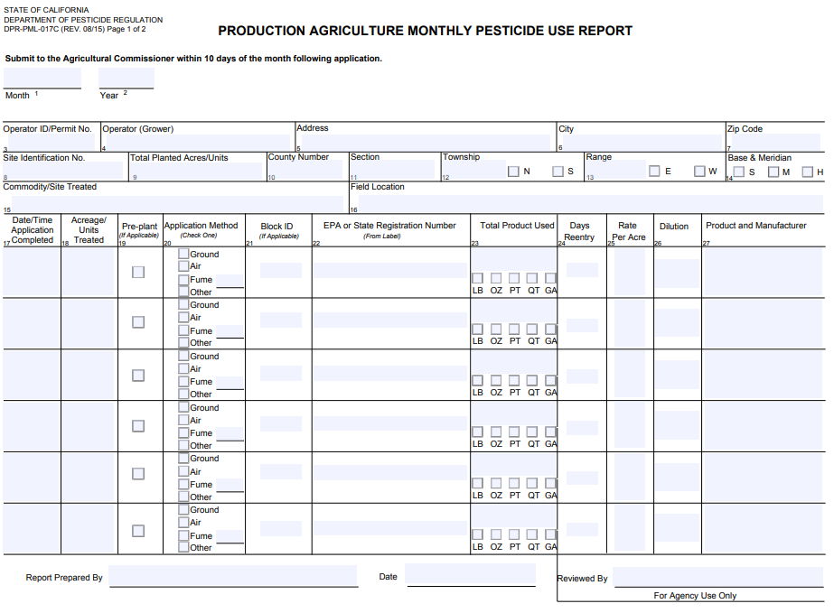

Slide 44
Key Points
Must have a pesticide permit from our office prior to making a pesticide application; make monthly reports for all applications.
Maintain necessary hazard communication documents.
Maintain all pesticide records, report all EPA Reg. usage.
Provide and maintain all necessary PPE and decontamination facilities.
Follow the label!

Slide 45
Nevada County Department of Agriculture
530-470-2690
agdept@co.nevada.ca.us
950 Maidu Ave #170
Nevada City, CA 95959

Slide 46
Employees, pesticides and cannabis
An overview of pesticide safety for commercial
operations with employees.

Slide 47
Pesticides and Cannabis
Pesticides
Worker Safety
Hazard Communication
Employee Training
Inspections

Slide 48
Role of California Ag Commissioners (CAC’s)
Performing inspections, compliance monitoring, and compliance assistance that focus on protecting pesticide applicators and workers
Investigating all priority incidents and illnesses
Issuing CEQA-compliant pesticide permits
Enforcing the requirements of pesticide product labeling and ensuring safe use.
The authority to perform these activities is defined in the Food and Ag Code (FAC) and California Code of Regulations (CCR).

Slide 49
Worker Safety

Slide 50
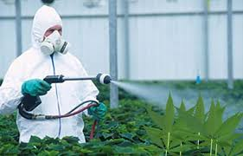
Worker Safety Program
Designed to reduce the risk of pesticide poisonings and injuries among pesticide handlers and other agricultural workers.
Worker Protection Standard
Hazard Communication
Training
Personal protective equipment (PPE)
Restricted Entry Intervals (REI)
Outreach

Slide 51
Emergency Medical Care Planned 3CCR § 6726/6766
For handlers and employees who enter treated fields/greenhouses, emergency medical care shall be planned for in advance. The employer shall locate and inform handler of the name and location of the facility. The name, address, and phone number shall be posted at the work site or work vehicle if there is no designated work site.
The local poison control center’s number, supervisor’s name with no additional information, or displaying “Call 9-1-1 in the case of Emergency”, is not acceptable.
For commercial production of an agricultural commodity, the employer shall provide to medical personnel treating the employee with the following: Copies the Safety Data Sheet(s), the product name(s), U.S. Environmental Protection Agency registration number(s), and active ingredient(s) for each pesticide product.

Slide 52
Personal Protective Equipment
The use of pesticides, with few exceptions, requires the applicator wear at least long pants, long sleeves, safety glasses/goggles, chemical resistant gloves, sock and shoes.
Pesticide labels may require additional equipment, such as a respirator or chemical resistant clothing.
It is the employers responsibility to provide all necessary PPE.

Slide 53
Proper Storage of Personal Protective Equipment 3CCR § 6738(a)
Does the employer provide for the daily inspection and cleaning of all required PPE, and repair or replace any worn, damaged, or heavily contaminated PPE?
Does the employer wash contaminated PPE separate from other clothing or laundry?
Does the employer assure that any person or firm assigned or hired to clean or repair potentially contaminated PPE is protected and informed?
PPE remains the property of the employer and that pesticide handlers are not to take contaminated PPE into their homes.
Employees who do not report to the employer's headquarters shall remove and store potentially contaminated coveralls in a sealable container outside of their living quarters.

Slide 54
Change Area 3CCR § 6732
Employers of persons who regularly handle any pesticides in commercial production of an agricultural commodity.
Employers of any persons who regularly handle pesticides with “DANGER” or “WARNING” on the labeling in any setting.
Sufficient water, soap and single use towels for routine washing and for emergency eye flushing and washing of the entire body.
Not meeting the requirements are, hand sanitizing gels and liquids or wet towelettes.

Slide 55
Hazard Communication

Slide 56
Hazard Communication
Employers must provide and maintain a written hazard communication program for their employees and provide unimpeded access to pesticide use records and Safety Data Sheets (SDS).
Requires notification before and after a chemical is used; re-notify if date changes.
Requires growers/applicators to ensure prior notification for any employees who walk within ¼-mile of a field to be treated under their control.
Requiring growers to notify employees who they know will likely enter a field to be treated, before and after the application.
Require growers and labor contractors to provide uncomplicated directions to where employees can find information about the pesticides used where they work, must be posted at a central location.

Slide 57
Hazard Communication
Examine the employer’s display of a completed Pesticide Safety Information Series (PSIS) leaflet A-8 or N-8 at the central location of the workplace. Is it complete? Do employees have unimpeded access to the document?
Verify that the employer is also maintaining, at a central location, the following documents:
• Pesticide use records for pesticides handled by employees.
• Copies of PSIS leaflets applicable to the pesticides and handling activities listed in the pesticide use records.
• The A-8 posted at all permanent decontamination facilities and decontamination facilities servicing 11 or more handlers.
• Changes in name, address, or telephone number of the facility providing emergency medical on the A-8 must be updated within 24 hours.
• Safety Data Sheet (SDS) for each pesticide handled by employees.

Slide 58
Application Specific Information Display for Handlers 3CCR § 6723.1
The operator of property used for the commercial or research production of an agricultural commodity when handler employees will be working within ¼ mile of any treated field.
Information shall remain up for the length of the restricted entry interval, plus 30 days if employees are on the establishment. The employer must display the following at a central location:
Crop or site treated and identification of the treated area.
• Date(s) and time(s) the application started and ended.
• Restricted entry interval.
• Product name, U.S. EPA registration number and active ingredients.
• Safety Data Sheet of the pesticide(s) applied.
• The ASI must be retained for two years

Slide 59
Hazard Communication for Fieldworkers 3CCR § 6761
The employer shall have a completed PSIS A-9 displayed at the following locations:
• At the worksite (If employees begin their workday at a central location, the PSIS A-9 may be displayed at that location instead of at the work site).
• All permanent decontamination facilities.
• Decontamination facilities servicing 11 or more fieldworkers.
Any changes to the name, address, or phone number to the medical facility providing care must be updated on the A-9 within 24 hours.

Slide 60
Application Specific Information for Fieldworkers 3CCR § 6761.1
• The operator of the property used for the commercial or research production of an agricultural commodity when fieldworkers will be working within ¼ mile of any treated field must provide an application specific information display (ASID). The ASID must remain displayed while there are treated fields and fieldworkers on the property.
• The employer of fieldworkers in a treated field must provide a description of the location of the ASID at the worksite (in conjunction with the PSIS A-9) or at a central location where all field workers gather before entering a field.

Slide 61
Application Specific Information for Fieldworkers 3CCR § 6761.1, con’t
Displayed – The information should be available to fieldworkers to review with unimpeded access. It can be posted, in a binder, in a file cabinet or available in another manner. The information is not displayed if workers must ask someone to see it. See 3CCR § 6000.
Complete – The display must contain: • Crop or site treated and identification of the treated field. • Date(s) and time(s) the application started and ended. • Restricted entry interval. • Product name(s), U.S. EPA registration number, and active ingredient. • Copy of the SDS(s) for the pesticide(s) applied. • Spray adjuvant product name(s) and the CA registration number(s) if applicable. • The required information must be retained for two years.
Timely – The information must be displayed at a central location while fieldworkers are employed to work in treated fields on the operator’s property until the area is no longer a treated field or no fieldworkers will be working on the operator’s property

Slide 62
Training

Slide 63
Handlers and Fieldworkers
Training is required for all employees who handle pesticides prior to handling, as well as fieldworkers prior to possible exposure, and every year there after.
Handler is defined as an employee that:
Mixes, loads, or applies pesticides;
Repairs or cleans equipment that was used for pesticides;
Touch unrinsed pesticide containers.
Fieldworker is defined as:
Anyone, including contract labor, that works on a farm, or in a greenhouse, or nursery, within 30 days of a pesticide application.

Slide 64
Handler Written Program 3CCR § 6724(a)
The employer shall have a written training program. The training program shall describe the materials (e.g., study guides, pamphlets, pesticide product labeling, Pesticide Safety Information Series leaflets, Safety Data Sheets, slides, video) and information that will be provided and used to train his or her employees and identify the person or firm that will provide the training.
The employer shall maintain a copy of the training program while in use and for two years after use, at a central location at the workplace.

Slide 65
Pesticide Safety Information Series (PSIS) A-Series
Training must incorporate the PSIS A-Series leaflets produced by DPR.
Subjects include hazard communication, first aid, medical supervision, (pesticide handler safety,) pesticide storage and transport, protective equipment, minimal exposure pesticides and respiratory protection.
Available in English, Spanish and Punjabi.

Slide 66
Handler Training 3CCR § 6724
Employers must train employees before they handle pesticides, update the training to cover new pesticides and repeat training at least annually (12- month period) thereafter.
Initial training may be waived if employees submit a record showing that training meeting the requirements of this regulation and covering the pesticides and use situations applicable to the new employment situation was received within the last year.
Employers must record the date of training and the job assigned to the employee and be verified with the employee’s signature. Records must be kept for two years in a central location at the workplace and accessible to employees.

Slide 67
Fieldworker Training 3CCR § 6764
Fieldworkers must have been trained prior to working in a treated field where pesticides have been used recently, and every 12 months there after.
Training must include:
Health Effects
Pesticide Safety
Treated field is a field that has been treated with a pesticide or had a restricted entry interval (REI) in effect within the last 30 days.

Slide 68
Trainer Qualified 3CCR § 6724(f)
(f) The person conducting the training for employees who will be handling pesticides for the commercial or research production of an agricultural plant commodity shall be qualified as one of the following:
(1) A California certified commercial applicator;
(2) A California certified private applicator;
(3) A person holding a valid County Biologist License in Pesticide Regulation or Investigation and Environmental Monitoring issued by the Department of Food and Agriculture;
(4) A University of California Extension Advisor;
(5) A person who has completed an “instructor training” program presented by one of the following: (A) the University of California, Integrated Pest Management Program; or (B) other instructor training program approved by the Director;
(6) A California licensed Agricultural Pest Control Adviser;
(7) A California Registered Professional Forester; or
(8) Other trainer qualification approved by the Director.

Slide 69
How to become a qualified trainer
Schedule to take the private applicator certificate (PAC) exam with the county ag department.
Exam is 70 multiple choice questions.
Questions cover a variety of pesticide safety topics, including understanding the label, mixing and application knowledge, and safety knowledge.
Must pass with a score of at least 70%.
Study materials:
Pesticide Series Information Sheets (PSIS A-Series); Read the Label handout; How to Calibrate handout; Pesticide Safety A Reference Manual for Private Applicators book.

Slide 70
Respiratory Protection Written Program 3CCR § 6739(a)
A written respiratory program is required when wearing respirators is required by any pesticide labeling, restricted material permit condition, regulation, the employer, or when employees voluntarily use respirators supplied by the employer.
Does not apply to employees who voluntarily use dust masks, or employees who voluntarily use any respirator not provided by the employer.
IF employers permit employees to use respirators when not required, 3CCR 6739(r) must be posted in the employee communication area next to the A-8.

Slide 71
Respiratory Protection Medical Evaluation 3CCR § 6739(q)(s); Fit Test Records 3CCR § 6739(p)(2) and (3)
IF required, employees will need a medical evaluation for respirator use, 3CCR 6739, and a fit test record must be on file, 3CCR 6739(p)(2,3); and those records must be maintained on site for three years.
Respiratory Protection Respirators Inspected 3CCR § 6739(j)(1)
Employers shall assure: • Maintain routine-use respirators when required by any pesticide labeling, restricted material permit condition, regulation or the employer. • Maintain emergency-use or second respirators to ensure air cylinders are at 100% of manufactures recommended capacity. • Emergency-use respirators are to be inspected monthly according to routine-use criteria, manufactures recommendations. • Escape only respirators must be inspected according to routine-use inspection criteria.

Slide 72
Respirator Storage 3CCR § 6739(h)(4)
Verify that respirators are stored in a manner that protects them from damage, contamination, dust, sunlight, extreme temperatures, excessive moisture and damaging chemicals. Respirators must also be stored in a manner that prevents the face-piece and exhalation valve from deformation.

Slide 73
Inspections and Enforcement

Slide 74
Enforcement
DPR, county agricultural commissioners and their staff are authorized under state law to enforce those provisions of state laws (Food and Ag Code) and regulations (Ca Code of Regs) as they pertain to pesticide use and safety.
Includes inspection authority and investigation procedures, issuing permits, worker safety, groundwater protection and surface water protection.
The goal is compliance with state laws and regulations; enforcement actions range from written violation notice to fines being assessed, depending on the severity, frequency, and previous history of similar violation(s).

Slide 75
Inspections
Field Worker Safety Inspection
anytime within 30 days of an application,
Confirm current permit,
Verify hazard communication, including completed PSIS A-8/A-9 posting, confirm it is complete, emergency medical care, etc.
Document field size, fieldworker activity, number of fieldworkers interviewed, pesticide name/registration number, signal word of product, required PPE (additional PPE may be required for entering during REI)
Confirm presence of decontamination materials (1 gallon water per employee, soap, single use towels) within1/4-mile of fieldworker working in a contaminated field.

Slide 76
Inspections
Pesticide Use Monitoring Inspection
Can be mix/load and/or application
Used to determine handler and employer compliance with all applicable conditions of permit, pesticide labeling requirements, training, and worker safety;
Confirms whether the handler and employer are mitigating any possible hazard to persons, non-target animal, crops and property;
Confirms ability to correctly identify the pesticide and to determine the compliance status of labeling requirements such as site, rate and handling precautions.

Slide 77
Inspections Pest Control Headquarters Inspection
Confirm current OIN/permit, 3CCR § 6622
All permit related records retained for 2 years, 3CCR § 6623, 3CCR § 6626
Review of training documents, must have a qualified trainer (QAC, QAL, PAC, PCA), written training program
Required posted employee documents (Hazard communication, respiratory program, planned emergency care posted, A-8, SDS),
Change area (water, soap and single use towels),
Storage of PPE (clean, good repair, employer responsible to clean and maintain), remains on property,
Pesticide storage – containers labeled, appropriate service containers, service container labeling, containers secured, signage posted if warning/danger,

Slide 78
Key Points
Must have a pesticide permit from our office prior to making a pesticide application; make monthly reports for all applications.
Develop a written training program for fieldworkers and handlers; maintain written training documents; train employees.
Maintain necessary hazard communication documents.
Provide and maintain all necessary PPE and decontamination facilities.
Follow the label!

Slide 79
Nevada County Department of Agriculture
530-470-2690
agdept@co.nevada.ca.us
950 Maidu Ave #170
Nevada City, CA 95959

