Slide 1


Cannabis: Weights and Measures Considerations
Tony Romero
Agricultural Biologist III
Nevada County Department of Agriculture/
Weights and Measures

Slide 2

Cannabis: Weights and Measures Considerations
Do I need to be a Weighmaster?
What Scales and Balances do I need to use?
Scale Selection Guidelines
NTEP Certified Class I and II Scales
https://www.cdfa.ca.gov/dms/CannabisWM.html

Slide 3
Do I need to be a Weighmaster?
YES!!!!
3 CCR 8213 Requirements for Weighing Devices and Weighmasters.
(a) Weighing devices used by a licensee shall be approved, registered, tested, and sealed pursuant to chapter 5 (commencing with section 12500) of division 5 of the Business and Professions Code and its implementing regulations and registered with the county sealer consistent with chapter 2 (commencing with section 12240) of division 5 of the Business and Professions Code and its implementing regulations.

Slide 4
Do I need to be a Weighmaster?
Approved, registered, tested, and sealed devices shall be used whenever any one or more of the following apply:
(1) Cannabis and non-manufactured cannabis products are bought or sold by weight or count;
(2) Cannabis and non-manufactured cannabis products are packaged for sale by weight or count;
(3) Cannabis and non-manufactured cannabis products are weighed or counted for entry into the track-and-trace system; or
(4) The weighing device is used for commercial purposes as defined in section 12500 of the Business and Professions Code.
(e) Any licensee weighing or measuring cannabis or non-manufactured cannabis product in accordance with subsection (a) shall be licensed as a weighmaster.

Slide 5
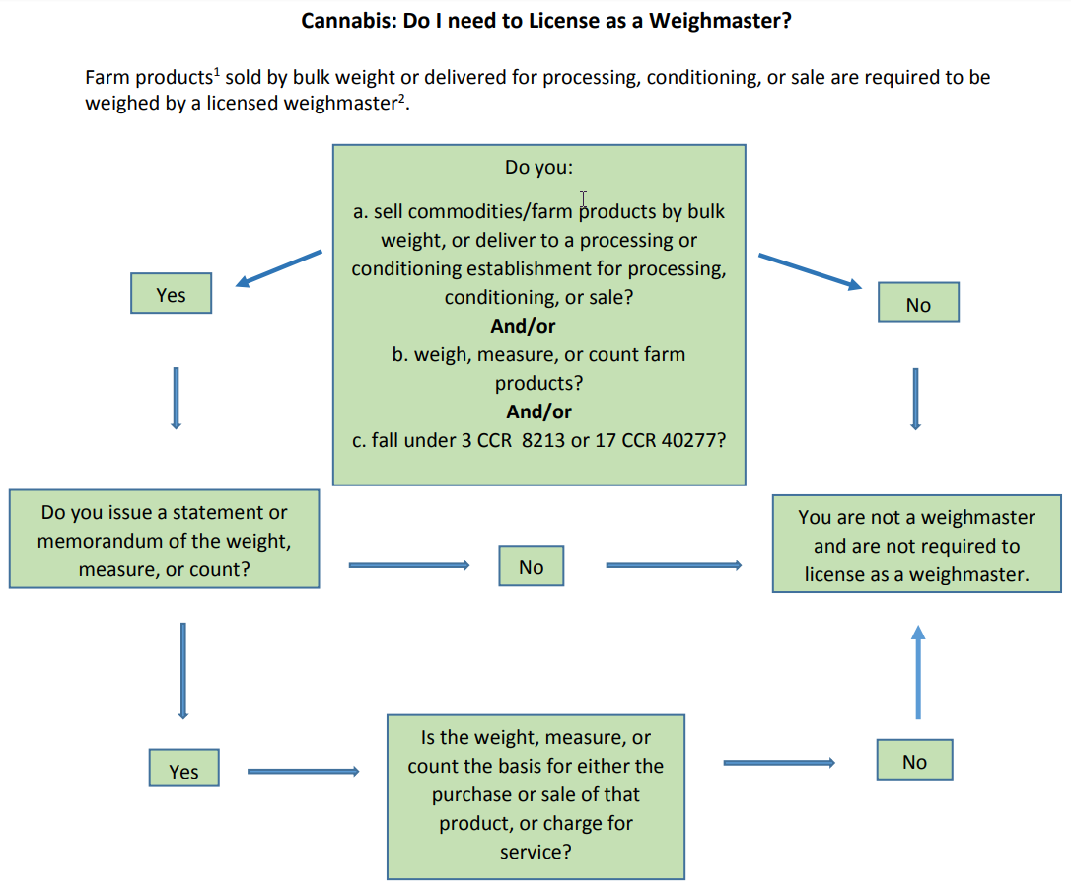

Slide 6
Do I Need to be a Weighmaster?
Weighmaster – Principal is usually the Business
Deputy Weighmaster
Are the only individuals that shall weigh, measure, or count any commodity and issues a statement or memorandum of the weight (Weighmaster Certificate)

Slide 7
Do I Need to be a Weighmaster?
Weighmaster Certificate
§ 12714. LEGEND AND WEIGHMASTER’S NAME TO APPEAR ON CERTIFICATE
There shall appear in an appropriate and conspicuous place on each certificate, and all copies thereof, the following legend:
WEIGHMASTER CERTIFICATE
THIS IS TO CERTIFY that the following described commodity was weighed, measured, or counted by a weighmaster, whose signature is on this certificate, who is a recognized authority of accuracy, as prescribed by Chapter 7 (commencing with Section 12700) of Division 5 of the California Business and Professions Code, administered by the Division of Measurement Standards of the California Department of Food and Agriculture.
(b) There shall also appear on each certificate, and all copies thereof, the printed name of the principal weighmaster as it appears on the license.

Slide 8
Do I Need to be a Weighmaster?
§ 12715. CONTENTS OF CERTIFICATE
Each certificate shall provide for the following information as applicable to the transaction:
(a) The date on which the weight, measure, or count was determined.
(b) The street address or location description and the city or township where the weighing, measuring, or counting occurred.
(c) The complete signature of the weighmaster who determined each weight, measure, or count. The name of a weighmaster may be imprinted electronically on the weighmaster certificate in lieu of a handwritten signature, if the electronically imprinted name is that of the weighmaster who weighed, measured, or counted the commodity or that of another weighmaster pursuant to Section 12712.

Slide 9
Do I Need to be a Weighmaster?
§ 12715. CONTENTS OF CERTIFICATE
(d) The kind of commodity and any other information that may be necessary to identify the product or distinguish it from a similar commodity.
(e) The number of units of the commodity. If not personally determined by a weighmaster, the certificate shall contain the words “driver’s count” or “loader’s count,” as appropriate, after the number of commodity units. The abbreviation “D.C.” or “L.C.” may be used in lieu of the complete words.
(f) The name of the owner, or his or her agent, and the consignee. If the transaction involves hay or hay products, the name and address of the grower, and his or her agent, as provided by the driver of the vehicle.
(g) At least one of the following:
(1) The gross weight of the commodity and the vehicle or container, if only the gross weight was determined.

Slide 10
Do I Need to be a Weighmaster?
§ 12715. CONTENTS OF CERTIFICATE
(2) The tare weight of the unladen vehicle or container, if only the tare weight was determined.
(3) The gross, tare, and net weights when a gross and tare are used in determining the net weight.
(4) The true net weight, measure, or count when no gross and tare weights are involved in determining the net quantity of the product.
(h) The tare weights, and the code identification or description of boxes, bins, pallets, or other containers.
(i) The correct identification of the vehicle, combination of vehicles, or other means by which the commodity was delivered. If an equipment number is used to identify a vehicle or combination of vehicles, there shall be traceability to the registered vehicle license numbers through the weighmaster’s records.
(j) The unit of measure, such as pounds, tons, gallons, kilograms, or cubic yards, used to identify the quantity.

Slide 11
Do I Need to be a Weighmaster?
All information contained on the certificate shall be clear and legible.
Each certificate shall be numbered consecutively.
Weighmaster Certificates must be kept for 4 years not including current year.
All Voided Weighmaster Certificates shall be maintained for records.

Slide 12
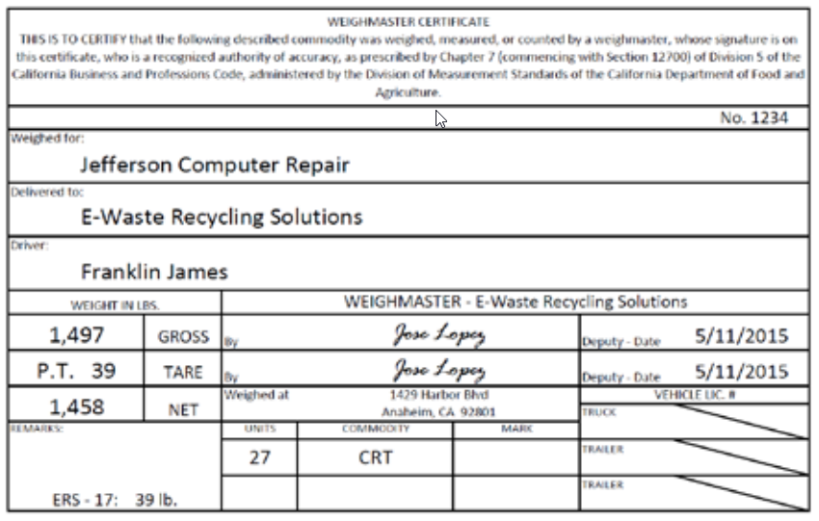
Do I Need to be a Weighmaster?

Slide 13
What Scales and Balances do I need to use?
Scale Selection Guidelines
NTEP Certified Class I, II and III Scales
http://www.ncwm.net/content/ntep

Slide 14
What Scales and Balances do I need to use?
Scale Selection Guidelines
Range of Weighing (minimum and maximum capacities)
Division Size (increments)
Precision (i.e., Scales that comply with Accuracy Class I, II & III parameters)
https://www.cdfa.ca.gov/dms/pdfs/CommercialScales.pdf

Slide 15
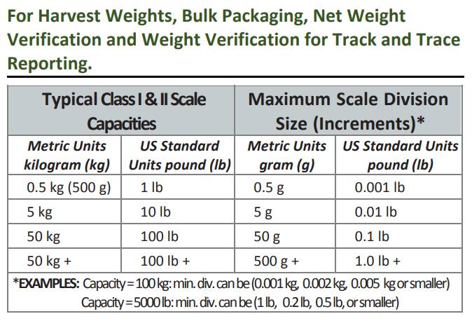
What Scales and Balances do I need to use?

Slide 16
What Scales and Balances do I need to use?
Type III
SI Units (International System of Units)
50 kgs x 0.001 kg (0.001 = 50 g; 0.005 = 25 g)
50 kgs+ x 0.01 kg (0.01 = 500 g)
Example of 50 kgs parameters:
100 kgs x 0.005 kg (0.005 = 500 g; 0.0025 = 250 g)
U.S. Customary Units (Standard Unit)
100 lbs x 0.1 lb
100+ lbs x 1.0 lb

Slide 17
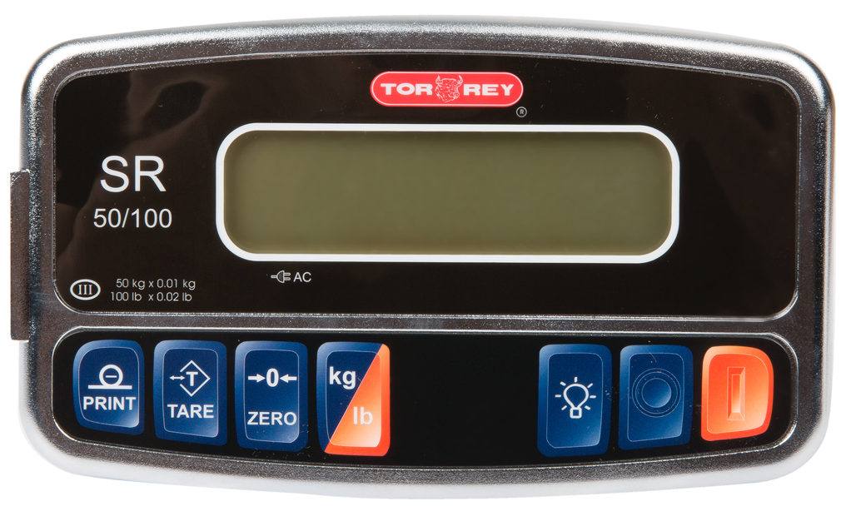
What Scales and Balances do I need to use?

Slide 18
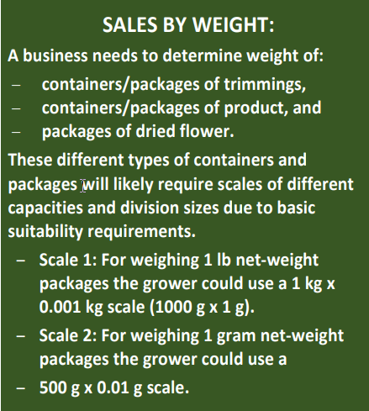
What Scales and Balances do I need to use?

Slide 19
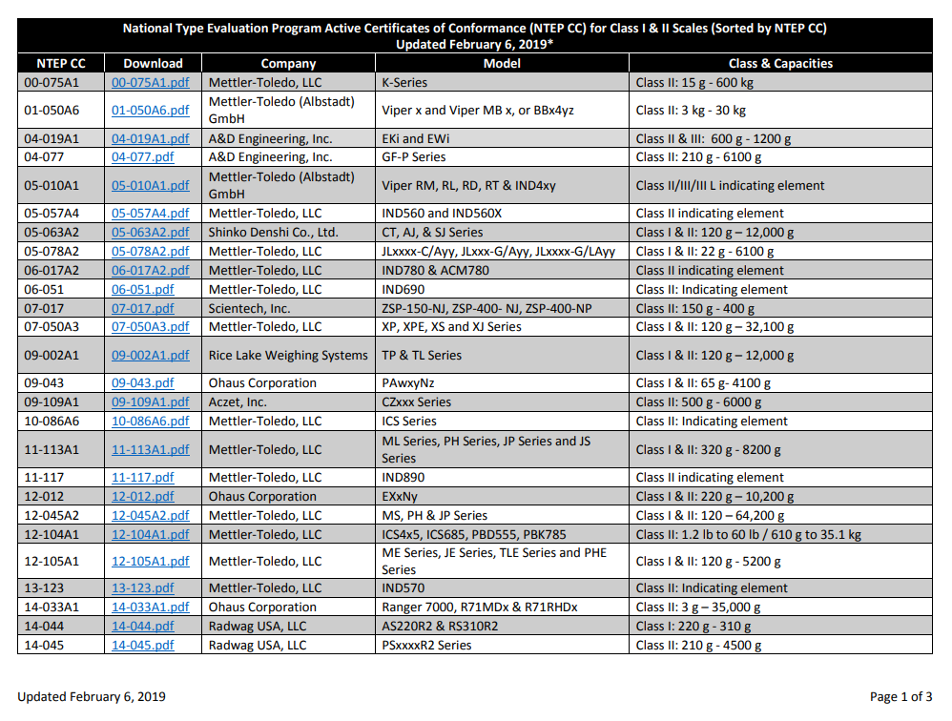
What Scales and Balances do I need to use?
https://www.cdfa.ca.gov/dms/pdfs/List_of_Class_I_and_II_scales_by_CC.pdf

Slide 20
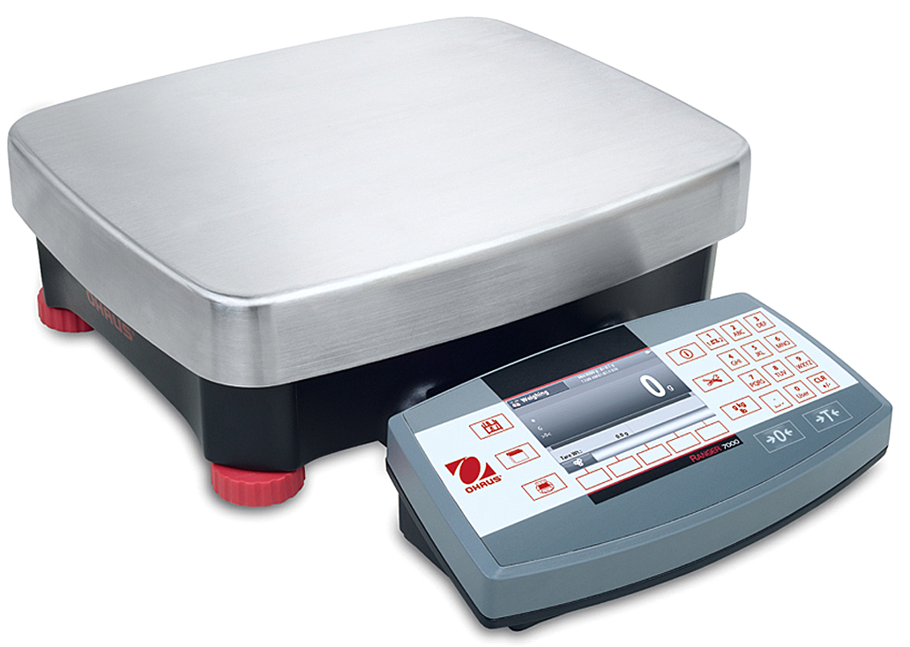
CDFA Division of Measurement Standards

Slide 21
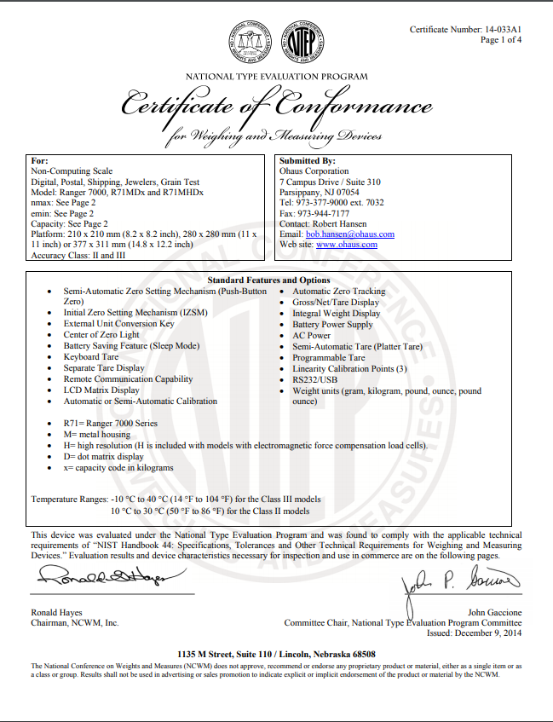
CDFA Division of Measurement Standards

Slide 22
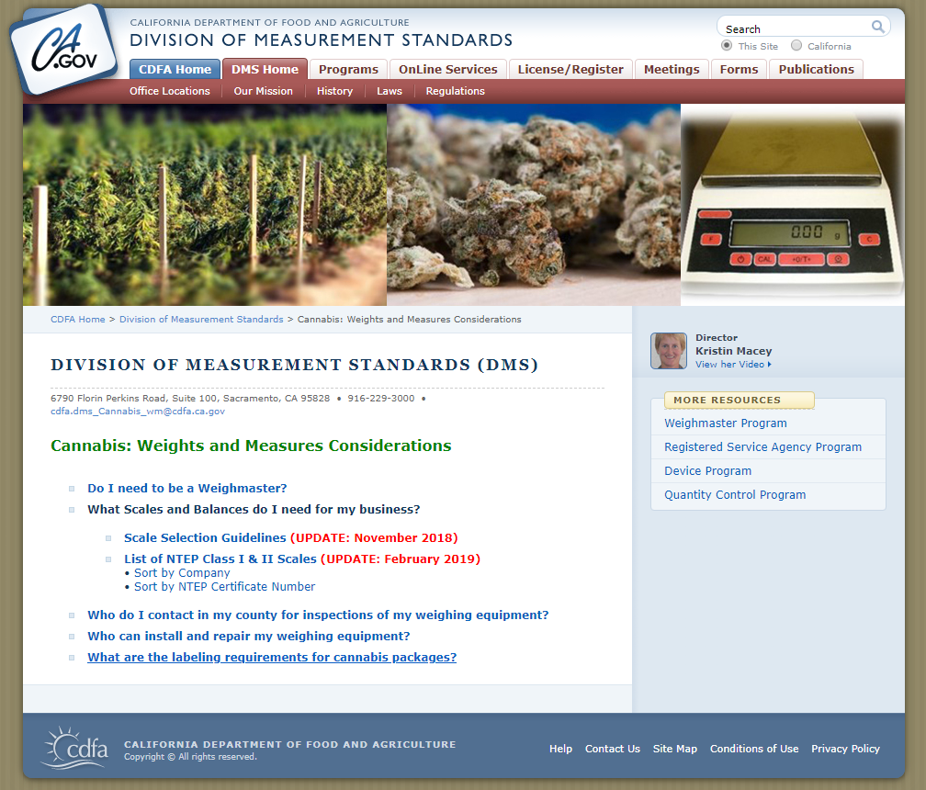
CDFA Division of Measurement Standards
https://www.cdfa.ca.gov/dms/CannabisWM.html

Slide 23
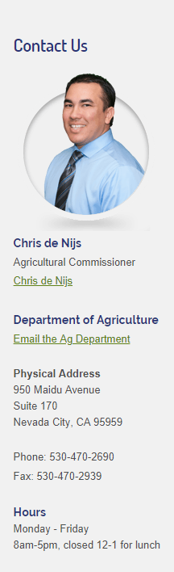
Nevada County Department of Agriculture/Weights and Measures
agdept@co.nevada.ca.us

