Slide 1
Pesticides and Cannabis
An overview of pesticides as they relate to cannabis production.

Slide 2
Pesticides and Cannabis
Jurisdictional Authorities
Pesticides
Worker Safety
Permits
Inspections

Slide 3
What is the difference between a law, a regulation and an ordinance?
Laws are introduced and passed by legislative bodies. There are federal laws passed by Congress and state laws passed by our senate. These are also referred to as codes, ie Food and Ag Code (FAC) or Business and Professions Code (B&P)
Regulations are promulgated by state agencies to carry out the particulars of laws. Regulations are the specifics of how laws are enforced. In California these are known as the California Code of Regulations, or CCR’s.
Counties and incorporated cities may promulgate ordinances which are usually codified in county and city codes, respectively.

Slide 4
Why is this important?
The federal government (US EPA) sets minimum pesticide use standards and delegates pesticide enforcement regulatory authority to the states.
This work is performed in cooperation by the Department of Pesticide Regulation (DPR) and the County Agricultural Commissioners (CAC’s) of California.
California’s pesticide laws and regulations are typically more rigorous, with the goal to protect people and the environment from harm caused by unsafe pesticide use.
Licensed agricultural biologists working for CAC’s issue site-specific permits, and conduct safety inspections and investigations.

Slide 5
Federal, State and Local Jurisdictions
Preemption refers to laws at one level of government taking precedence over laws of a lower level.
As such, no entity at the lower level can pass a law that allows action that would violate the higher-level law.
In pesticides, federal law (FIFRA) clearly states that only the federal government has authority over pesticide labeling.
California has preemption over local ordinances with regard to cannabis use, ie local cannabis ordinances will not address pesticides.

Slide 6
Role of Feds/US EPA
Federal Insecticide, Fungicide, and Rodenticide Act (FIFRA) authorizes state regulation of the sale and use of federally registered pesticides as long as the states regulations are at least as restrictive as federal standards.

Slide 7
Role of California - DPR
Reviews/registers pesticides approved by US EPA for use in California.
Licensing commercial pesticide applicators, including pest control dealers, brokers, maintenance gardeners, pest control advisors and qualified applicators.
Provides training and oversite to county agricultural commissioners and their staff.

Slide 8

Role of California Ag Commissioners (CAC’s)
Performing inspections, compliance monitoring, and compliance assistance that focus on protecting pesticide applicators and workers
Investigating all priority incidents and illnesses
Issuing CEQA-compliant pesticide permits
Enforcing the requirements of pesticide product labeling and ensuring safe use.
The authority to perform these activities is defined in the Food and Ag Code (FAC) and California Code of Regulations (CCR).

Slide 9
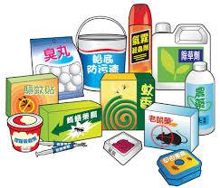
What is a pesticide?
Pesticide is an umbrella term for all herbicides, rodenticides, miticides, fungicides, antimicrobials, etc.
A pesticide is defined as anything used to mitigate a pest.
Pesticides are also used in organic agriculture.

Slide 10
Pesticide Registration
US EPA and DPR review all new pesticides prior to registration to ensure effectiveness and will not harm human health or the environment when used according to label directions.
Under FIFRA, a small subset of low-risk pesticides are exempt from registration if they meet certain criteria, (Section 25b), and are typically substances such as garlic, peppermint, rosemary, cedar and castor oil.

Slide 11
The Label is Law!!
The pesticide label is a legal document.
Products must be labeled properly, and found suitable for the intended use.
All pesticide product labels include a signal word, warning statement, precautionary statements for protecting human and environmental health, storage and disposal statements, and directions for use.
By law, all pesticide users must follow the label. Any off label use of a pesticide use is a violation.

Slide 12
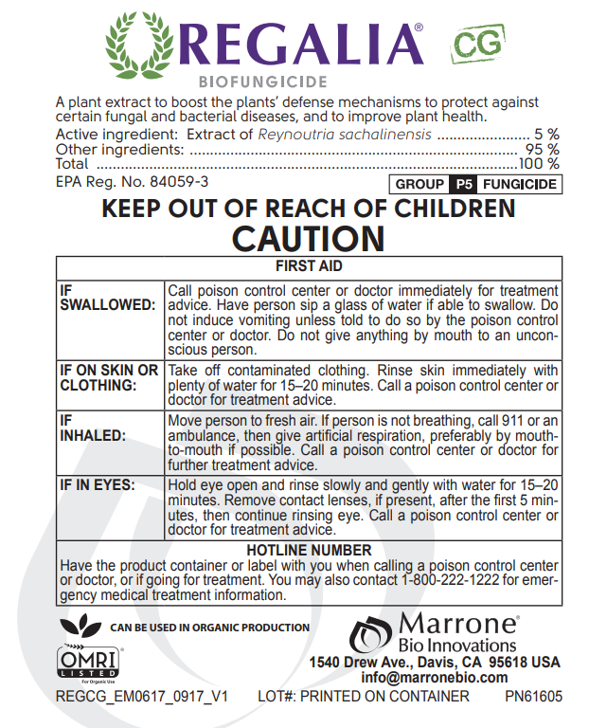
Elements of a label
Name
Active ingredients
EPA Reg. No.
Signal Word: Caution
First Aid Instructions
Manufacturer

Slide 13
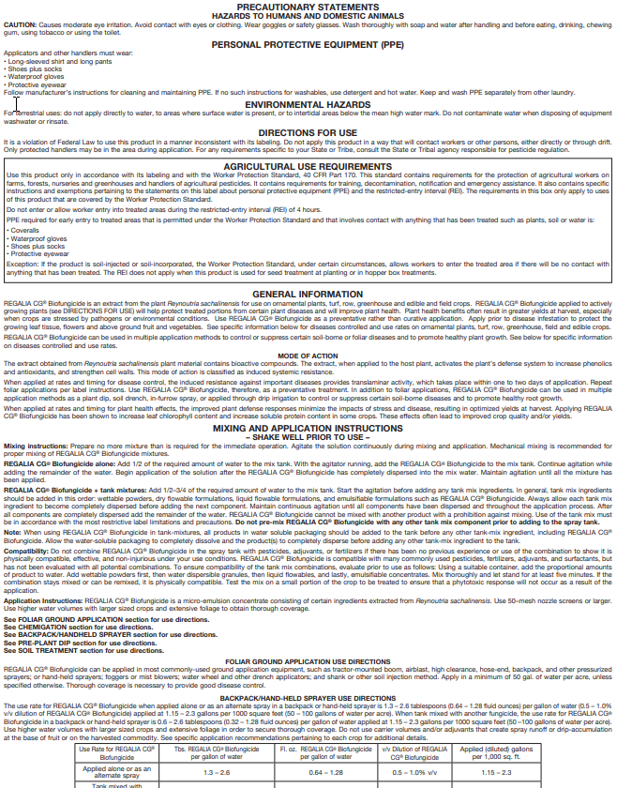
Elements of a label
Precautionary Statements
Required PPE
Environmental Hazards
Directions for Use – FIFRA statement
Agricultural Use Requirements
Restricted Entry Interval (REI)
General Information
Mixing and Application Instructions, with notes on types of mixtures and applications, continues

Slide 14
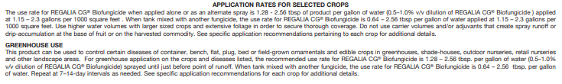
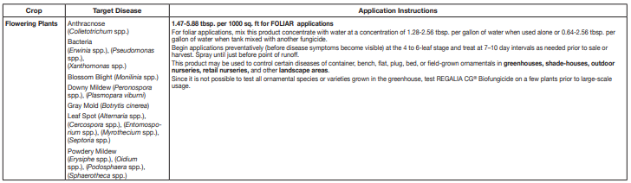
Elements of a label

Slide 15
Legal Ramifications for Cannabis
Residue tolerance requirements are set by U.S. EPA for each pesticide on each food crop and are the amount of pesticide residue allowed to remain in or on each treated crop with “reasonable certainty of no harm.”
US EPA will not establish pesticide residue tolerances for cannabis due to its federal status.
A pesticide product can legally be applied to cannabis under state law if:
the active ingredients found in the product are exempt from residue tolerance requirements, and
the product is either exempt from registration requirements (Section 25(b)) or registered for a use that’s broad enough to include use on cannabis.

Slide 16
Ag Commissioner Pest Management Review
Must have an actual product to review, ie Regalia CG EPA Reg No. 84059-3, not just a generic active ingredient.
Is it an allowed active ingredient?
Is the label broad enough to interpret for use on cannabis?
Is it intended for agricultural production vs home use?
Will the listed inert ingredients be a problem for EPA Food Residue Tolerances?
CalCannabis License Applications require a pest-management plan to include a signed attestation that the applicant shall contact the appropriate County Agricultural Commissioner prior to using the pesticides listed in the pest-management plan. Sections 8106(a)(3)(C)

Slide 17
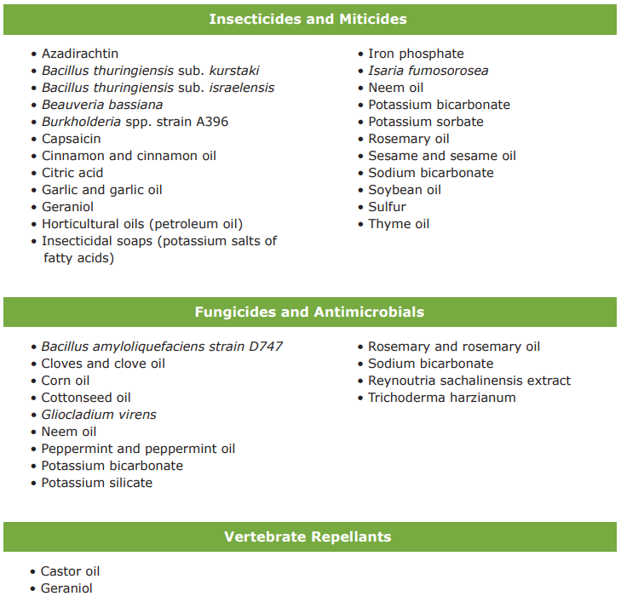
Possibly Allowed Active Ingredients
This is not an exhaustive list of active ingredients that may fit the legal use criteria. DPR/Ag Commissioner does not track products that fit the criteria and the user bears the responsibility for ensuring product labels meet the criteria.

Slide 18
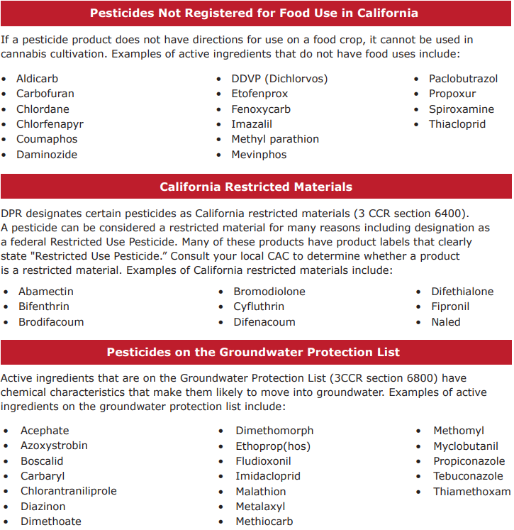
Never allowed!
The following criteria identify pesticide products that cannot be used in California cannabis cultivation under any circumstances. The use of any pesticides meeting any one of these criteria on cannabis will be strictly enforced as a violation of the FAC and could result in civil or criminal penalties (FAC sections 12996 and 12999.5)
Residues found in any amounts of these substances will fail testing.

Slide 19
16CCR 5719 Residual Pesticide Testing
(d)The sample shall be deemed to have passed the residual pesticides testing if both of the following conditions are met:
(1) The presence of any residual pesticide listed in the following tables in Category I are not detected, and
(2) The presence of any residual pesticide listed in the following tables in Category II does not exceed the indicated action levels.
(e) If the sample fails residual pesticides testing, the batch from which the sample was collected fails residual pesticides testing and shall not be released for retail sale.

Slide 20
Residue Tolerances Category 1 and 2
 | Action Level (μg/g)
Residual Pesticide | CAS No. | Inhalable Cannabis Goods | Other Cannabis Goods
Abamectin | 71751-41-2 | 0.1 | 0.3
Acephate | 30560-19-1 | 0.1 | 5
Acequinocyl | 57960-19-7 | 0.1 | 4
Acetamiprid | 135410-20-7 | 0.1 | 5
Azoxystrobin | 131860-33-8 | 0.1 | 40
Bifenazate | 149877-41-8 | 0.1 | 5
Bifenthrin | 82657-04-3 | 3 | 0.5
Boscalid | 188425-85-6 | 0.1 | 10
Captan | 133-06-2 | 0.7 | 5
Carbaryl | 63-25-2 | 0.5 | 0.5
Chlorantraniliprole | 500008-45-7 | 10 | 40
Clofentezine | 74115-24-5 | 0.1 | 0.5
Cyfluthrin | 68359-37-5 | 2 | 1
Cypermethrin | 52315-07-8 | 1 | 1
Diazinon | 333-41-5 | 0.1 | 0.2
Dimethomorph | 110488-70-5 | 2 | 20
Etoxazole | 153233-91-1 | 0.1 | 1.5
Fenhexamid | 126833-17-8 | 0.1 | 10
Fenpyroximate | 111812-58-9 | 0.1 | 2
Flonicamid | 158062-67-0 | 0.1 | 2
Fludioxonil | 131341-86-1 | 0.1 | 30
Hexythiazox | 78587-05-0 | 0.1 | 2
Imidacloprid | 138261-41-3 | 5 | 3
Kresoxim-methyl | 143390-89-0 | 0.1 | 1
Malathion | 121-75-5 | 0.5 | 5
Metalaxyl | 57837-19-1 | 2 | 15
Methomyl | 16752-77-5 | 1 | 0.1
Myclobutanil | 88671-89-0 | 0.1 | 9
Naled | 300-76-5 | 0.1 | 0.5
Oxamyl | 23135-22-0 | 0.5 | 0.2
Pentachloronitrobenzene | 82-68-8 | 0.1 | 0.2
Permethrin | 52645-53-1 | 0.5 | 20
Phosmet | 732-11-6 | 0.1 | 0.2
Piperonylbutoxide | 51-03-6 | 3 | 8
Prallethrin | 23031-36-9 | 0.1 | 0.4
Propiconazole | 60207-90-1 | 0.1 | 20
Pyrethrins | 8003-34-7 | 0.5 | 1
Pyridaben | 96489-71-3 | 0.1 | 3
Spinetoram | 187166-15-0, 187166-40-1 | 0.1 | 3
Spinosad | 131929-60-7, 131929-63-0 | 0.1 | 3
Spiromesifen | 283594-90-1 | 0.1 | 12
Spirotetramat | 203313-25-1 | 0.1 | 13
Tebuconazole | 107534-96-3 | 0.1 | 2
Thiamethoxam | 153719-23-4 | 5 | 4.5
Trifloxystrobin | 141517-21-7 | 0.1 | 30
Category I
Residual Pesticide | CAS No.
Aldicarb | 116-06-3
Carbofuran | 1563-66-2
Chlordane | 57-74-9
Chlorfenapyr | 122453-73-0
Chlorpyrifos | 2921-88-2
Coumaphos | 56-72-4
Daminozide | 1596-84-5
DDVP (Dichlorvos) | 62-73-7
Dimethoate | 60-51-5
Ethoprop(hos) | 13194-48-4
Etofenprox | 80844-07-1
Fenoxycarb | 72490-01-8
Fipronil | 120068-37-3
Imazalil | 35554-44-0
Methiocarb | 2032-65-7
Methyl parathion | 298-00-0
Mevinphos | 7786-34-7
Paclobutrazol | 76738-62-0
Propoxur | 114-26-1
Spiroxamine | 118134-30-8
Thiacloprid | 111988-49-9

Slide 21
Selling commercial pesticides
Only licensed pest control dealers may sell agriculture use pesticides, regardless of the other uses that may appear on the labeling.
Dealers are required to:
Have a licensed supervisor onsite at each branch location
Maintain records of purchases, sales, and distribution of pesticides
Must ensure anyone purchasing an agriculture use pesticide has an OIN
Anyone repackaging pesticides must register with the US EPA to become a pesticide producing establishment. DPR and our office have been performing outreach to known hydroponic stores to ensure compliance.

Slide 22
Some misconceptions
Organic does not equal lack of pesticide use.
“Home use” products available at most garden centers and hardware stores cannot be used in the production of an agricultural commodity.
Homemade remedies are still pesticides and subject to FIFRA.
Anything used as a pesticide falls under FIFRA, and needs to have a label to determine correct use. Common household products like soap or vinegar do not have a pesticide label, so any use of such a product to control pests is an off-label use and a violation.

Slide 23
Pesticide Permits

Slide 24
Pesticide Permits Operator Identification Number Obtained 3CCR § 6622
Formally called operator identification number (OIN), commonly referred to a pesticide permits.
Obtained from each County Agriculture Commissioner for the county in which commodity is being grown.
Allows for CEQA equivalency review for sensitive sites such as hospitals, school sites, day care centers, beehives, and endangered species, and to apply permit conditions and limitations.
Allows for the purchase AND use of commercial-grade pesticides.
Expire on December 31 of each year and must be renewed.
Must be obtained prior to the purchase and use of a pesticide.

Slide 25
Pesticide Reporting Pesticide Use Records Available / 2 Years 3CCR § 6624 Pesticide Use Reports Submitted 3CCR § 6626 /6627
Pesticide reporting for commercial production is performed on a monthly basis to the county agricultural commissioner. Reports must include the following:
Date and time of the application(s)
Operator identification number (aka permit number), name and address
Site identification and commodity treated
Acres or units planted and treated
Amount of product applied with it’s name and US EPA registration number, or if an adjuvant, the California registration number.
Reports are due by the 10th day of the month following the applications.
Must be kept for 2 years
Reports can be made via paper or online.

Slide 26
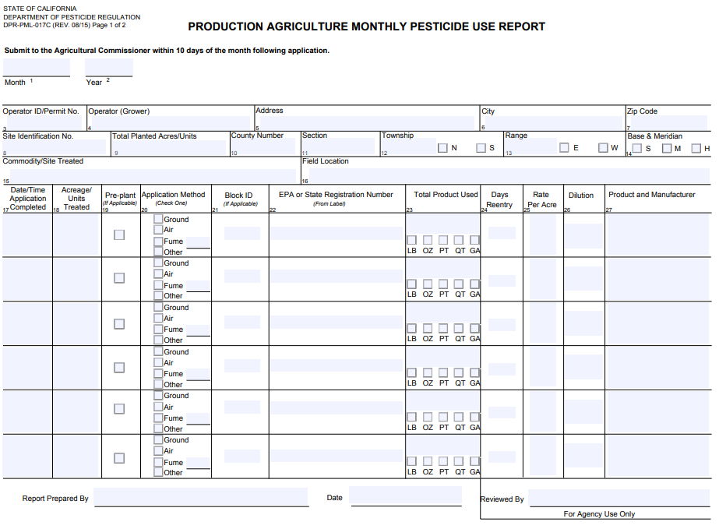

Slide 27
Worker Safety

Slide 28
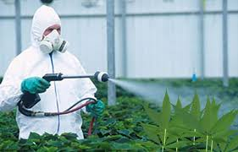
Worker Safety Program
Designed to reduce the risk of pesticide poisonings and injuries among pesticide handlers and other agricultural workers.
Worker Protection Standard
Hazard Communication
Training
Personal protective equipment (PPE)
Restricted Entry Intervals (REI)
Outreach

Slide 29
Emergency Medical Care Planned 3CCR § 6726/6766
For handlers and employees who enter treated fields/greenhouses, emergency medical care shall be planned for in advance. The employer shall locate and inform handler of the name and location of the facility. The name, address, and phone number shall be posted at the work site or work vehicle if there is no designated work site.
The local poison control center’s number, supervisor’s name with no additional information, or displaying “Call 9-1-1 in the case of Emergency”, is not acceptable.
For commercial production of an agricultural commodity, the employer shall provide to medical personnel treating the employee with the following: Copies the Safety Data Sheet(s), the product name(s), U.S. Environmental Protection Agency registration number(s), and active ingredient(s) for each pesticide product.

Slide 30

Personal Protective Equipment
The use of pesticides, with few exceptions, requires the applicator wear at least long pants, long sleeves, safety glasses/goggles, chemical resistant gloves, sock and shoes.
Pesticide labels may require additional equipment, such as a respirator or chemical resistant clothing.
It is the employers responsibility to provide all necessary PPE.

Slide 31
Proper Storage of Personal Protective Equipment 3CCR § 6738(a)
Does the employer provide for the daily inspection and cleaning of all required PPE, and repair or replace any worn, damaged, or heavily contaminated PPE?
Does the employer wash contaminated PPE separate from other clothing or laundry?
Does the employer assure that any person or firm assigned or hired to clean or repair potentially contaminated PPE is protected and informed?
PPE remains the property of the employer and that pesticide handlers are not to take contaminated PPE into their homes.
Employees who do not report to the employer's headquarters shall remove and store potentially contaminated coveralls in a sealable container outside of their living quarters.

Slide 32
Change Area 3CCR § 6732
Employers of persons who regularly handle any pesticides in commercial or research production of an agricultural plant commodity.
Employers of any persons who regularly handle pesticides with “DANGER” or “WARNING” on the labeling in any setting.
Sufficient water, soap and single use towels for routine washing and for emergency eye flushing and washing of the entire body.
Not meeting the requirements are, hand sanitizing gels and liquids or wet towelettes.

Slide 33
Hazard Communication

Slide 34
Hazard Communication
Employers must provide and maintain a written hazard communication program for their employees and provide unimpeded access to pesticide use records and Safety Data Sheets (SDS).
Requires notification before and after a chemical is used; re-notify if date changes.
Requires growers/applicators to ensure prior notification for any employees who walk within ¼-mile of a field to be treated under their control.
Requiring growers to notify employees who they know will likely enter a field to be treated, before and after the application.
Require growers and labor contractors to provide uncomplicated directions to where employees can find information about the pesticides used where they work, must be posted at a central location.

Slide 35
Hazard Communication
Examine the employer’s display of a completed Pesticide Safety Information Series (PSIS) leaflet A-8 or N-8 at the central location of the workplace. Is it complete? Do employees have unimpeded access to the document?
Verify that the employer is also maintaining, at a central location, the following documents:
• Pesticide use records for pesticides handled by employees.
• Copies of PSIS leaflets applicable to the pesticides and handling activities listed in the pesticide use records.
• The A-8 posted at all permanent decontamination facilities and decontamination facilities servicing 11 or more handlers.
• Changes in name, address, or telephone number of the facility providing emergency medical on the A-8 must be updated within 24 hours.
• Safety Data Sheet (SDS) for each pesticide handled by employees.

Slide 36
Application Specific Information Display for Handlers 3CCR § 6723.1
The operator of property used for the commercial or research production of an agricultural commodity when handler employees will be working within ¼ mile of any treated field.
Information shall remain up for the length of the restricted entry interval, plus 30 days if employees are on the establishment. The employer must display the following at a central location:
Crop or site treated and identification of the treated area.
• Date(s) and time(s) the application started and ended.
• Restricted entry interval.
• Product name, U.S. EPA registration number and active ingredients.
• Safety Data Sheet of the pesticide(s) applied.
• The ASI must be retained for two years

Slide 37
Hazard Communication for Fieldworkers 3CCR § 6761
The employer shall have a completed PSIS A-9 displayed at the following locations:
• At the worksite (If employees begin their workday at a central location, the PSIS A-9 may be displayed at that location instead of at the work site).
• All permanent decontamination facilities.
• Decontamination facilities servicing 11 or more fieldworkers.
Any changes to the name, address, or phone number to the medical facility providing care must be updated on the A-9 within 24 hours.

Slide 38
Application Specific Information for Fieldworkers 3CCR § 6761.1
• The operator of the property used for the commercial or research production of an agricultural commodity when fieldworkers will be working within ¼ mile of any treated field must provide an application specific information display (ASID). The ASID must remain displayed while there are treated fields and fieldworkers on the property.
• The employer of fieldworkers in a treated field must provide a description of the location of the ASID at the worksite (in conjunction with the PSIS A-9) or at a central location where all field workers gather before entering a field.

Slide 39
Application Specific Information for Fieldworkers 3CCR § 6761.1, con’t
Displayed – The information should be available to fieldworkers to review with unimpeded access. It can be posted, in a binder, in a file cabinet or available in another manner. The information is not displayed if workers must ask someone to see it. See 3CCR § 6000.
Complete – The display must contain: • Crop or site treated and identification of the treated field. • Date(s) and time(s) the application started and ended. • Restricted entry interval. • Product name(s), U.S. EPA registration number, and active ingredient. • Copy of the SDS(s) for the pesticide(s) applied. • Spray adjuvant product name(s) and the CA registration number(s) if applicable. • The required information must be retained for two years.
Timely – The information must be displayed at a central location while fieldworkers are employed to work in treated fields on the operator’s property until the area is no longer a treated field or no fieldworkers will be working on the operator’s property

Slide 40
Training

Slide 41
Handlers and Fieldworkers
Training is required for all employees who handle pesticides prior to handling, as well as fieldworkers prior to possible exposure, and every year there after.
Handler is defined as an employee that:
Mixes, loads, or applies pesticides;
Repairs or cleans equipment that was used for pesticides;
Repair or remove (pesticide) tarps on a field;
Touch unrinsed pesticide containers.
Fieldworker is defined as:
Anyone that works on a farm, or in a greenhouse, or nursery.

Slide 42
Written Program 3CCR § 6724(a)
The employer shall have a written training program. The training program shall describe the materials (e.g., study guides, pamphlets, pesticide product labeling, Pesticide Safety Information Series leaflets, Safety Data Sheets, slides, video) and information that will be provided and used to train his or her employees and identify the person or firm that will provide the training.
The employer shall maintain a copy of the training program while in use and for two years after use, at a central location at the workplace.

Slide 43
Pesticide Safety Information Series (PSIS) A-Series
Training must incorporate the PSIS A-Series leaflets produced by DPR.
Subjects include hazard communication, first aid, medical supervision, (pesticide handler safety,) pesticide storage and transport, protective equipment, minimal exposure pesticides and respiratory protection.
Available in English, Spanish and Punjabi.

Slide 44
Handler Training 3CCR § 6724
Employers must train employees before they handle pesticides, update the training to cover new pesticides and repeat training at least annually (12- month period) thereafter.
Initial training may be waived if employees submit a record showing that training meeting the requirements of this regulation and covering the pesticides and use situations applicable to the new employment situation was received within the last year.
Employers must record the date of training and the job assigned to the employee and be verified with the employee’s signature. Records must be kept for two years in a central location at the workplace and accessible to employees.

Slide 45
Fieldworker Training 3CCR § 6764
Fieldworkers must have been trained prior to working in a treated field where pesticides have been used recently, and every 12 months there after.
Training must include:
Health Effects
Pesticide Safety
Treated field is a field that has been treated with a pesticide or had a restricted entry interval (REI) in effect within the last 30 days.

Slide 46
Trainer Qualified 3CCR § 6724(f)
(f) The person conducting the training for employees who will be handling pesticides for the commercial or research production of an agricultural plant commodity shall be qualified as one of the following:
(1) A California certified commercial applicator;
(2) A California certified private applicator;
(3) A person holding a valid County Biologist License in Pesticide Regulation or Investigation and Environmental Monitoring issued by the Department of Food and Agriculture;
(4) A University of California Extension Advisor;
(5) A person who has completed an “instructor training” program presented by one of the following: (A) the University of California, Integrated Pest Management Program; or (B) other instructor training program approved by the Director;
(6) A California licensed Agricultural Pest Control Adviser;
(7) A California Registered Professional Forester; or
(8) Other trainer qualification approved by the Director.

Slide 47
Respiratory Protection Written Program 3CCR § 6739(a)
A written respiratory program is required when wearing respirators is required by any pesticide labeling, restricted material permit condition, regulation, the employer, or when employees voluntarily use respirators supplied by the employer.
Does not apply to employees who voluntarily use dust masks, or employees who voluntarily use any respirator not provided by the employer.
IF employers permit employees to use respirators when not required, 3CCR 6739(r) must be posted in the employee communication area next to the A-8.

Slide 48
Respiratory Protection Medical Evaluation 3CCR § 6739(q)(s); Fit Test Records 3CCR § 6739(p)(2) and (3)
IF required, employees will need a medical evaluation for respirator use, 3CCR 6739, and a fit test record must be on file, 3CCR 6739(p)(2,3); and those records must be maintained on site for three years.
Respiratory Protection Respirators Inspected 3CCR § 6739(j)(1)
Employers shall assure: • Maintain routine-use respirators when required by any pesticide labeling, restricted material permit condition, regulation or the employer. • Maintain emergency-use or second respirators to ensure air cylinders are at 100% of manufactures recommended capacity. • Emergency-use respirators are to be inspected monthly according to routine-use criteria, manufactures recommendations. • Escape only respirators must be inspected according to routine-use inspection criteria.

Slide 49
Respirator Storage 3CCR § 6739(h)(4)
Verify that respirators are stored in a manner that protects them from damage, contamination, dust, sunlight, extreme temperatures, excessive moisture and damaging chemicals. Respirators must also be stored in a manner that prevents the face-piece and exhalation valve from deformation.

Slide 50
Pesticide Containers and Storage

Slide 51
Containers Secured 3CCR § 6672(b)
Any person who controls the use of a property and stores any pesticide. Any person, delivering empty, or full containers of any pesticide to a property.
If pesticides, containers or equipment are not in a locked enclosure you must determine if responsible persons on site are adequately attending them. Factors include the proximity of the containers to public access, the proximity of the attending person to the containers and the level of attention the attending person can provide.

Slide 52
Service Container Labeling 3CCR § 6678
All containers, other than the original manufacturer’s labeled container, used to store or hold pesticides , transport dilute or concentrated mixtures of any pesticide down a public road to another site.
Service containers, other than those used by a person engaged in the business of farming when the containers are used on the property the person is farming, shall be labeled with:
(a) the name and address of the person or firm responsible for the container;
(b) the identity of the pesticide in the container; and
(c) the word “Danger,” “Warning,” or “Caution” in accordance with the label on the original container.

Slide 53
Containers Properly Rinsed 3CCR § 6684
Handlers must triple rinse and drain containers at the time of use. Handlers must add the rinsate to the mix tank and use the rinsate in the application. Time of use means prior to the end of the mix/load operation.
Puncturing the containers is recommended in order to allow for drainage and aeration. Unrinsed or improperly rinsed containers are considered hazardous waste.
Consult pesticide label for any additional requirements.

Slide 54
Prohibited Containers for Pesticides 3CCR § 6680
All pesticides being used, transported or in storage.
If service containers or measuring devices are used, ensure that pesticides are not being placed in prohibited containers commonly used for food, drink or household products.
Examples of improper storage containers include empty coffee cans, soda bottles or cans or cooking vessels.

Slide 55

Pesticide Storage Containers Labeled/Closures 3CCR § 6676
Commercial pesticides must be kept in a secure (locked) location.
If they have the signal word of “warning” or “danger”, signage must be posted visible at 25’ from the location or entrance where the materials are stored.

Slide 56
Inspections and Enforcement

Slide 57
Enforcement
DPR, county agricultural commissioners and their staff are authorized under state law to enforce those provisions of state laws (Food and Ag Code) and regulations (Ca Code of Regs) as they pertain to pesticide use and safety.
Includes inspection authority and investigation procedures, issuing permits, worker safety, groundwater protection and surface water protection.
The goal is compliance with state laws and regulations; enforcement actions range from written violation notice to fines being assessed, depending on the severity, frequency, and previous history of similar violation(s).

Slide 58
Inspections
Field Worker Safety Inspection
anytime within 30 days of an application,
Confirm current permit,
Verify hazard communication, including completed PSIS A-8/A-9 posting, confirm it is complete, emergency medical care, etc.
Document field size, fieldworker activity, number of fieldworkers interviewed, pesticide name/registration number, signal word of product, required PPE (additional PPE may be required for entering during REI)
Confirm presence of decontamination materials (1 gallon water per employee, soap, single use towels) within1/4-mile of fieldworker working in a contaminated field.

Slide 59
Inspections
Pesticide Use Monitoring Inspection
Can be mix/load and/or application
Used to determine handler and employer compliance with all applicable conditions of permit, pesticide labeling requirements, training, and worker safety;
Confirms whether the handler and employer are mitigating any possible hazard to persons, non-target animal, crops and property;
Confirms ability to correctly identify the pesticide and to determine the compliance status of labeling requirements such as site, rate and handling precautions.

Slide 60
Inspections Pest Control Headquarters Inspection
Confirm current OIN/permit, 3CCR § 6622
All permit related records retained for 2 years, 3CCR § 6623, 3CCR § 6626
Review of training documents, must have a qualified trainer (QAC, QAL, PAC, PCA), written training program
Required posted employee documents (Hazard communication, respiratory program, planned emergency care posted, A-8, SDS),
Change area (water, soap and single use towels),
Storage of PPE (clean, good repair, employer responsible to clean and maintain), remains on property,
Pesticide storage – containers labeled, appropriate service containers, service container labeling, containers secured, signage posted if warning/danger,

Slide 61
Key Points
Must have a pesticide permit from our office prior to making a pesticide application; make monthly reports for all applications.
Must have your Pest Management Plan reviewed by our office prior to first pesticide use.
Develop a written training program for fieldworkers and handlers; maintain written training documents; train employees.
Maintain necessary hazard communication documents.
Provide and maintain all necessary PPE and decontamination facilities.
Follow the label!

Slide 62
Nevada County Department of Agriculture
530-470-2690
agdept@co.nevada.ca.us
950 Maidu Ave #170
Nevada City, CA 95959

