Slide 1
Assisted Outpatient Treatment
(W&I Code 5345) (AB 1421)
“Laura’s Law”
The Nevada County Experience
May 7th, 2015

Slide 2
Jan 1, 2003
California enacted court-ordered outpatient treatment, known as Assisted Outpatient Treatment (AOT), as an option for Counties
Modeled after Kendra’s Law in New York
45 states have similar laws
Resulting from a collaboration with Treatment Advocacy Center, parents of victim, and state legislators

Slide 3
Stigma
Not our intention to promote stigma of persons with mental illness
We embrace recovery principles and the belief that all individuals can recover and live satisfying and productive lives
We recognize that a small subset of persons with untreated mental illness, especially those with a co-occurring substance use disorder, may have a high potential to be dangerous to themselves or others

Slide 4
Issues to Consider
AOT is too expensive
AOT violates civil rights
Voluntary treatment is more effective than AOT
AOT is not needed because we already have other interventions (e.g. 5150 and 5350)

Slide 5
Issues to Consider
AOT allows forced medication
AOT is not effective because you can’t force medication
AOT outcomes are not documented
AOT won’t work in counties with diverse cultural and ethnic populations

Slide 6
AOT Criteria
Lack of compliance with treatment, indicated by:
2/36 months; hospital, prison, jail or
1/48 months; serious and violence acts, threats, attempts to self /others
(the element of dangerousness is a lower threshold than 5150 or 5350, not an imminent threat, not gravely disabled)

Slide 7
AOT Criteria
  The person has been offered an opportunity to participate in treatment and failed to engage, or refused
  (therefore, voluntary services are not an alternative to AOT, as AOT requires that voluntary services have already been offered and refused)

Slide 8
WIC 5150 and WIC 5350 Criteria-Not Met
These individuals do not pose an imminent danger to self or others, and do not meet WIC 5150 criteria
These individuals are not gravely disabled, and so do not meet WIC 5350 criteria (i.e. Conservatorship)
Therefore, simply attempting to hospitalize or conserve them is not a viable option

Slide 9
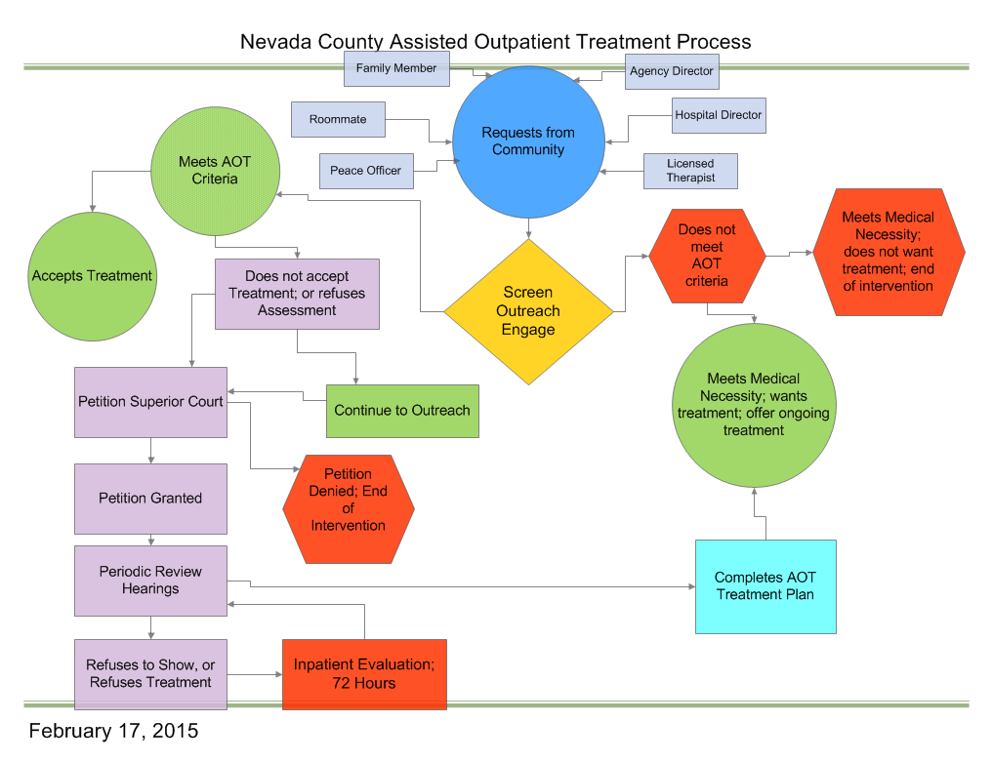

Slide 10
AOT Program Requirements
Community-based, multi-disciplinary treatment, 24/7 on-call support, mental health teams that use staff to client ratios of no more than 10 clients per 1 staff person
Must include a Personal Service Coordinator (PSC) for full service coordination
Team approach and capacity for frequent contacts
For Example: Assertive Community Treatment (ACT)

Slide 11
AOT Program Requirements
Services that are client directed and employ recovery principles
Integrated services that include mental health, substance abuse, physical health
Self management of their illness, personal choice and self determination
Benefit advocacy

Slide 12
Outreach
Ongoing process; no set time limit
Outreach to individuals, families, friends, health providers
Emergency housing and health care
Court order allows outreach to be possible to this population

Slide 13
Individualized Service Plans
Access necessary health care
Create and maintain a support system
Live in the most independent and least restrictive housing option; transitional and permanent
Work or other productive activity
Reduce or eliminate contact with criminal justice system

Slide 14

No Forced Medication
Medication may be part of the court-ordered, individualized service plan
Medications are not “forced”, but they are court-ordered
Court-ordered treatment is commonly provided throughout the California mental health system
Almost all participants take medication

Slide 15
Court-Ordered Treatment
Counties typically provide treatment to individuals with court orders for mental health treatment:
LPS Conservatees
Individuals on probation; mental health court
Parents ordered into treatment in dependency court

Slide 16
Providence Center AOT Data
Since May 2008:
82 referrals for AOT evaluations ; 67 unduplicated individuals
37 AOT court orders; 30 unduplicated individuals
6 incomplete orders due to hospitalization, incarceration, or death
Approximately 6 people per year have received an AOT court order

Slide 17
Providence Center AOT Data
5 adversarial hearings (i.e. where the person appeared with counsel and challenged the petition.)
4 hearings where the person did not appear; an evidentiary hearing was held before the judge to present the evidence that the person met criteria.

Slide 18

Costs and Savings
Actual cost per individual varies; budget for Fiscal Year 14/15 projected at $20,736/year/individual = same as ACT Team cost
Average length of stay is 180 days
$1.81 is saved for every $1 invested
Bill Medi-Cal, Medicare, private insurance, patient fees for allowable services
AOT costs are similar to ACT costs

Slide 19
Actual Outcomes: For 19 unduplicated individuals, for the most recent
12 months pre-treatment vs. 12 months post-treatment
Psychiatric Hospital Days
510 days vs. 290 days post-treatment = 43.1%
Incarceration Days
687 days vs. 327 days post-treatment = 52.4%
Homeless Days
254 days vs. 117 days post-treatment = 53.9%

Slide 20
Actual Outcomes: For 19 unduplicated individuals, for the most recent
12 months pre-treatment vs. 12 months post-treatment
Satisfaction Rating: 72.4%
MORS Extreme Risk 38.9% 6.5%
MORS Coping/Rehabilitating 0.0% 40.0%

Slide 21

Court & Legal Process
3 components -
  Pre-hearing notice of investigation and hearing
  Court hearings and due process requirements
  Collaborative supervision of AOT after the court order
  Typical courtroom experience?

Slide 22
Court & Legal Process
County files a petition and the licensed mental health treatment provider may testify
The petition must be served on:
  Person who is subject to the petition
  County Office of Patient Rights
  Current health care provider appointed
The petition must determine there is no appropriate/feasible less restrictive option

Slide 23
Court & Legal Process
County provider must file an affidavit (declaration) with the court at 60-day intervals (or sooner if determined by the team and/or court)
The declaration does not require a hearing, unless the court has set one in advance
Affidavit reflects level of participation and whether the person continues to meet criteria.
Includes individualized recommendations or modifications that may be discussed in court

Slide 24
Final Thoughts
Nine California Counties are in various stages of implementation of AOT: Nevada, Yolo, San Francisco, Los Angeles, Placer, San Diego, Contra Costa, Mendocino, and Orange
45 states have adopted legislation to implement AOT
AOT saves lives, protects civil rights, increases public safety, and improves the quality of life for the individual
Provides treatment before an individual becomes gravely disabled, or does harm to self or others

Slide 25
Final, Final Thoughts
AOT fills a gap in the treatment continuum
AOT allows for a treatment option that is less restrictive than Conservatorship and locked inpatient care
AOT is not a panacea, but does support the possibility of engaging some individuals in treatment that would not otherwise be possible
It is possible to create a recovery based AOT program

Slide 26
Contact Information
Michael Heggarty, MFT
Nevada County Health and Human Services
michael.heggarty@co.nevada.ca.us
Carol Stanchfield, MFT
Turning Point Providence Center
Carolstanchfield@tpcp.org
Honorable Judge Thomas Anderson
Nevada County Superior Court
Tom.Anderson@nevadacountycourts.com

Slide 27

Laura Wilcox

