Slide 1
Assisted Outpatient Treatment (W&I Code 5345) (AB 1421) “Laura’s Law” March 5, 2013
The Nevada County Experience

Slide 2
Jan 10, 2001
3 people were killed by an untreated mentally ill individual in Nevada County, including Laura Wilcox, “Laura’s Law”
Several critically wounded
Entire community closed down and fearful

Slide 3
Jan 1, 2003
California enacted court-ordered outpatient treatment, known as Assisted Outpatient Treatment (AOT), as an option for Counties
Modeled after Kendra’s Law in New York
44 states have similar laws
Resulting from a collaboration with Treatment Advocacy Center, parents of victim, and state legislators

Slide 4
Nevada County Process
No funding attached to legislation
County resolved to use any available means to prevent future tragedies
Mental Health Services Act (MHSA) funding was mentioned as possible funding source

Slide 5
Nevada County Process
Approval from Department of Mental Health to use MHSA funds to implement treatment components of AOT, May 2007
Board of Supervisor’s approval to implement AOT, April 2008
Implemented and began services, May 2008

Slide 6
AOT Criteria
County resident, minimum age 18
Serious Mental Disorder (WIC 5600.3)
The person is unlikely to survive safely in the community

Slide 7
AOT Criteria
Lack of compliance with treatment, indicated by:
2/36 months; hospital, prison, jail or
1/48 months; serious and violence acts, threats, attempts to self /others

Slide 8
AOT Criteria
The person has been offered an opportunity to participate in treatment and failed to engage, or refused
Condition is deteriorating
Least restrictive placement
Necessary to prevent 5150 condition
Will benefit from treatment

Slide 9
Who Can Request AOT?
Any person 18 and older with whom the person resides
The person’s parent, spouse, sibling or child, who is 18 or older
A peace officer, parole or probation officer

Slide 10
Who Can Request AOT?
The director of a public or private agency providing mental health services to the person
The director of a hospital where the person is being treated
A licensed mental health provider who is supervising or treating the person

Slide 11
AOT Program Requirements
Community-based, multi-disciplinary treatment, 24/7 on-call support, Individualized Service Plans, outreach, least restrictive housing options, mental health teams that use staff to client ratios of no more than 10 clients per staff
Must include a Personal Service Coordinator (PSC) for full service coordination
For Example: Assertive Community Treatment (ACT)

Slide 12
AOT Program Requirements
Stakeholder service planning and delivery.
Individual Service Plan
Comprehensive list of wraparound mental health, social, physical health, and housing services

Slide 13
AOT Program Requirements
Specific strategies for AOT service recipients and stakeholders, such as families
Comprehensive training and education program provided to AOT mental health treatment providers, law enforcement, probation, court personnel, hearing officers, and community at large

Slide 14
Voluntary v. Involuntary
The “involuntary” exclusion related to using MHSA funds is referenced in:
DMH Letter 05-05.
“Programs funded under the Mental Health Services Act must be voluntary in nature. Individuals accessing services funded by the Mental Health Services Act may have voluntary or involuntary legal status which shall not effect their ability to access the expanded services under this Act.”
Title 9 CCR, § 3400. “(b) Programs and/or services provided with MHSA funds shall:
(2) Be designed for voluntary participation. No person shall be denied access based solely on his/her voluntary or involuntary legal status.”

Slide 15
Voluntary v. Involuntary
So, in order to use MHSA funds, the programs and services must be voluntary in nature and designed for voluntary participation.
However, the statute and policy letter clearly stipulate that an individual’s involuntary legal status shall not prevent an individual from accessing MHSA funded services.

Slide 16

Voluntary v. Involuntary
Nevada County believes AOT is allowable; no locks, restraints, seclusion, or forced medication
Bills currently introduced to clarify language and specifically allow use of MHSA funds
AOT services provided by the ACT Team are voluntary; the mandate, legal status, and order originate from the court

Slide 17

No Forced Medication
Medication may be part of the court-ordered, individualized service plan
Medications are not “forced”, but they are court-ordered
Court-ordered treatment is commonly provided throughout the California mental health system

Slide 18
Court-Ordered Treatment
Counties typically provide treatment funded by MHSA to individuals with court orders for mental health treatment:
LPS Conservatees
Individuals on probation/parole
Parents ordered into treatment in dependency court

Slide 19
Court-Ordered Treatment
Mental Health Court participants
Court Wards
Court Dependents
Most children and adolescents are ‘involuntary’, even if not court-ordered!

Slide 20
AOT/ACT For Everyone on Demand?
WIC 5348(b) “A county that provides assisted outpatient treatment services pursuant to this article also shall offer the same services on a voluntary basis.”
Does not mean anyone can demand AOT and automatically receive the service!
It does mean you need to have non-court-ordered ACT services available; you may still apply criteria, medical necessity, ‘as resources are available’, etc.
Bill currently introduced to remove this requirement.

Slide 21

Court & Legal Process
3 components -
Pre-filing arraignment of the person and investigation
Court hearings and due process requirements
Collaborative supervision of AOT after the court order

Slide 22
Court & Legal Process
County files a petition and may testify
The petition must be served on:
Person who is subject to the petition
County Office of Patient Rights
Current health care provider appointed
The petition must determine there is no appropriate/feasible less restrictive option
County must file an affidavit with the court at 60-day intervals (or sooner if determined by the team and/or court)

Slide 23
Provider role
Offers ACT to the person referred
Investigates/Assesses whether the person meets full criteria
Prepares documents for County Counsel in support of petition
Provides Notice of Hearing to the individual
Provides AOT treatment following court order

Slide 24
Additional Provider Tasks
Collaboration: with law enforcement, probation and public defenders/private lawyers, conservator
Support: in court and/or hospital settings, correctional facilities and in successfully completing all steps required of the individual by the court

Slide 25
Additional Supports
Assist client with housing options
Assistance with entitlements (Social Security, Medi-Cal)
Psychiatric medication
Medical issues
Community integration
Substance Use Disorder counseling and treatment
Life Skills training

Slide 26
Providence Center AOT Data
61 referrals and evaluations (54 unduplicated individuals)
The majority of people engaged in treatment with no court order
23 court orders (including Settlement Agreements) for treatment

Slide 27
AOT Program Oversight
Report to State DHCS specific outcomes
WIC 5349. “This article shall be operative in those counties in which the county board of supervisors, by resolution, authorizes its application and makes a finding that no voluntary mental health program serving adults, and no children's mental health program, may be reduced as a result of the implementation of this article.”
Monitors programs to ensure training requirements are met
Bill currently introduced to remove this requirement

Slide 28

Costs and Savings
Actual cost per individual varies; approximately $15,411/year/individual = ACT Team cost
Average length of stay is 180 days
$1.81 is saved for every $1 invested
Bill Medi-Cal, Medicare, private insurance, patient fees for allowable services
AOT costs are similar to ACT costs

Slide 29
Costs and Savings
Both costs and savings change almost daily, so it is difficult to maintain ongoing actuals.
Findings are well documented by research in other states and published studies.

Slide 30
AOT Outcomes Are Similar to ACT Outcomes
Fewer hospital days
Fewer jail days
Higher employment rates
Less homelessness
Overall cost savings
Better treatment engagement
Higher Milestones of Recovery scores

Slide 31
Actual Outcomes: For 39 unduplicated individuals, for the most recent 12 months pre-treatment vs. 12 months post-treatment
# of Psychiatric Hospital Days
571 days vs. 207 days post-treatment = 63.7% ↓
# of Incarceration Days
823 days vs. 603 days post-treatment = 26.7% ↓
# of Homeless Days
2096 days vs. 1408 days post-treatment = 32.8% ↓
# of Emergency Interventions
84 contacts vs. 30 contacts post-treatment = 64.3% ↓

Slide 32

2011 National Association of Counties Achievement Award
reduction in actual hospital costs of $213,300
reduction in actual incarceration costs of $75,600
a net savings to the County of $503,621 for 31 months
“The total AOT program costs of $483,443, plus the actual hospital and jail costs for 31 months of $136,200, was $618,643. Based on utilization data from 12 months to implementation of AOT, the projected hospital plus jail costs without AOT for the same 31 months would be $1,122,264, representing a net savings to the County of $503,621.”

Slide 33

Consider Barriers to Treatment…
Lack of insight (anosognosia), is a significant barrier to treatment
“Impaired or lack awareness of illness - a neurological syndrome called anosognosia - is believed to be the single largest reason why individuals with schizophrenia and bipolar disorder do not take their medications. It is caused by damage to specific parts of the brain, especially the right hemisphere, and affects approximately 50 percent of individuals with schizophrenia and 40 percent of individuals with bipolar disorder.”
Severe symptoms
Stigma
Lack of support
Homelessness
Undiagnosed mental illness
Cultural barriers

Slide 34
Final Thoughts
Nevada County is the first and only California County to fully implement AOT
44 states have implemented AOT programs
AOT saves lives, protects civil rights, increases public safety, and improves the quality of life for the individual
Provides treatment before an individual becomes gravely disabled, or does harm to self or others

Slide 35
Final, Final Thoughts
AOT fills a gap in the treatment continuum
AOT allows for a treatment option that is less restrictive than Conservatorship and locked inpatient care
AOT is not a panacea, but does support the possibility of engaging some individuals in treatment that would not otherwise be possible
It is possible to create a recovery based AOT program

Slide 36
Contact Information
Michael Heggarty, MFT
Nevada County Behavioral Health
michael.heggarty@co.nevada.ca.us
Carol Stanchfield, MS, LMFT
Turning Point Providence Center
carolstanchfield@tpcp.org
Honorable Judge Thomas Anderson
Nevada County Superior Court
Tom.Anderson@nevadacountycourts.com

Slide 37
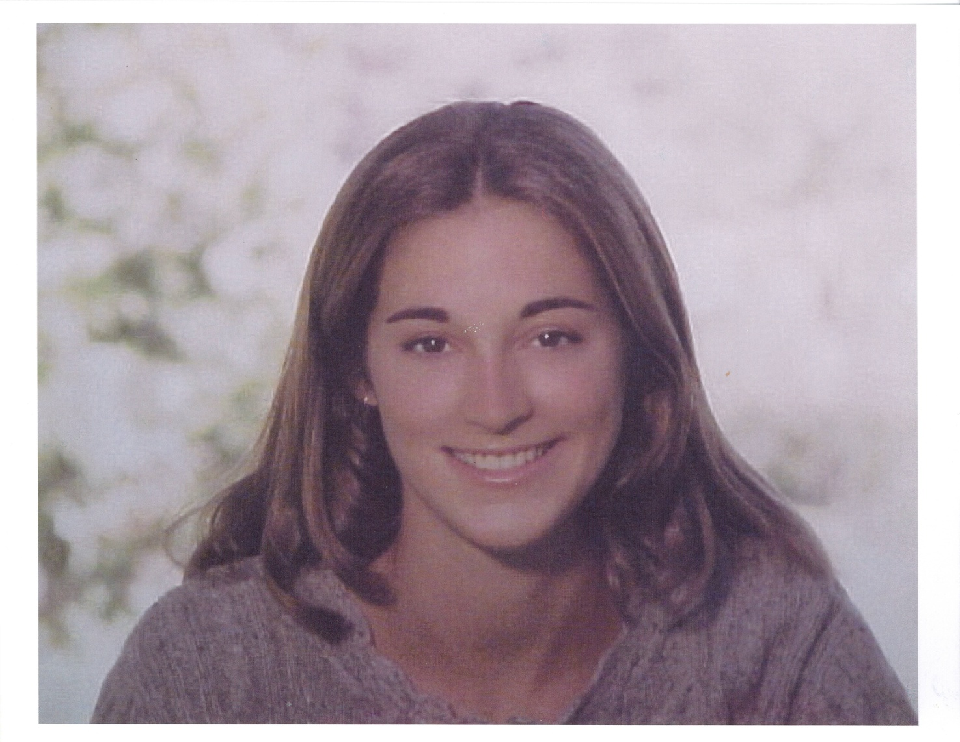
Laura Wilcox

